Slide 2
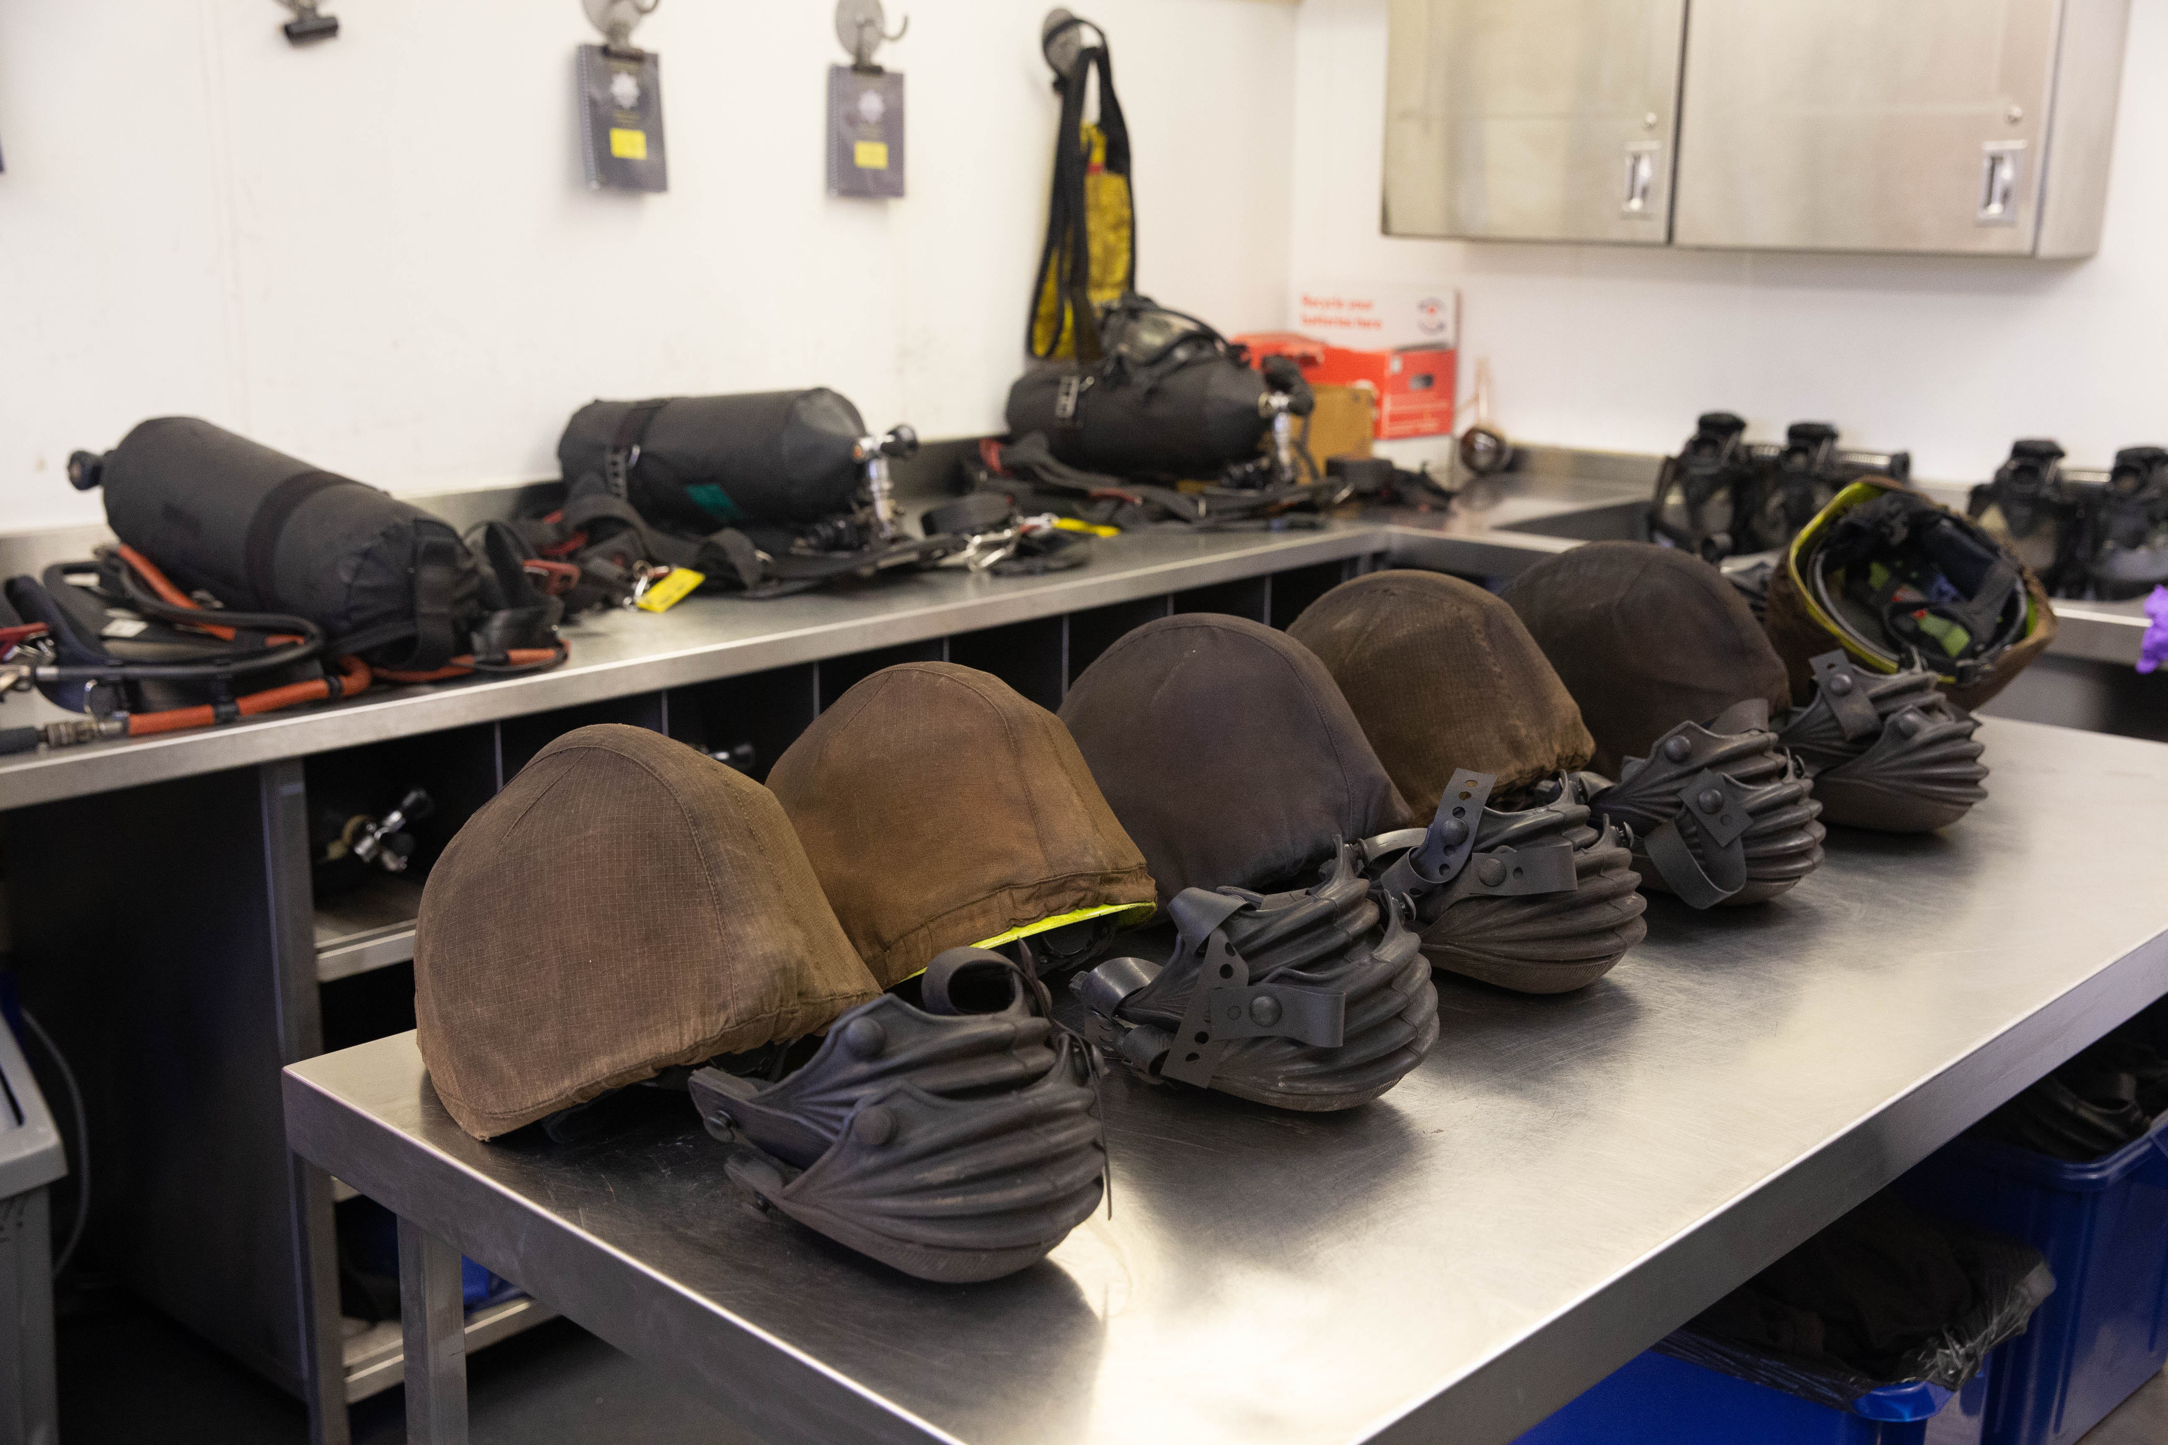
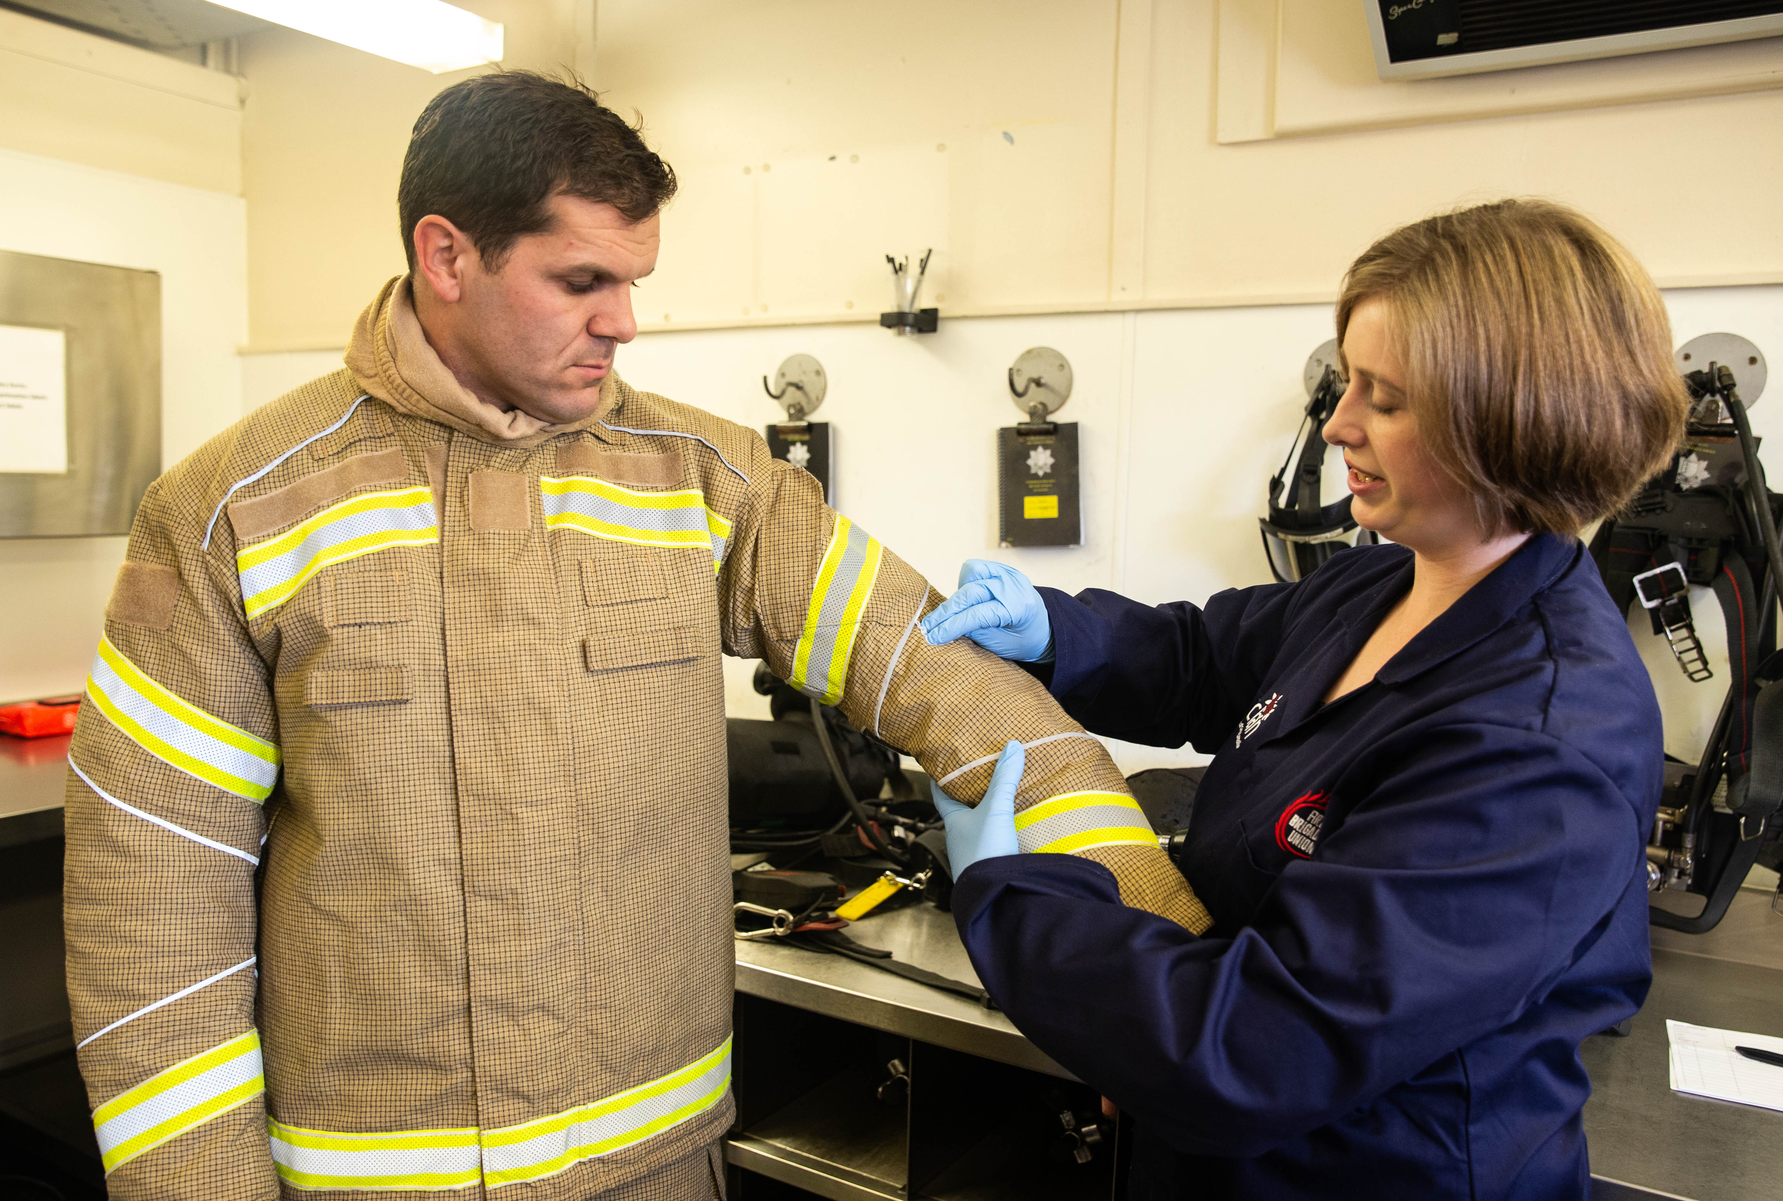
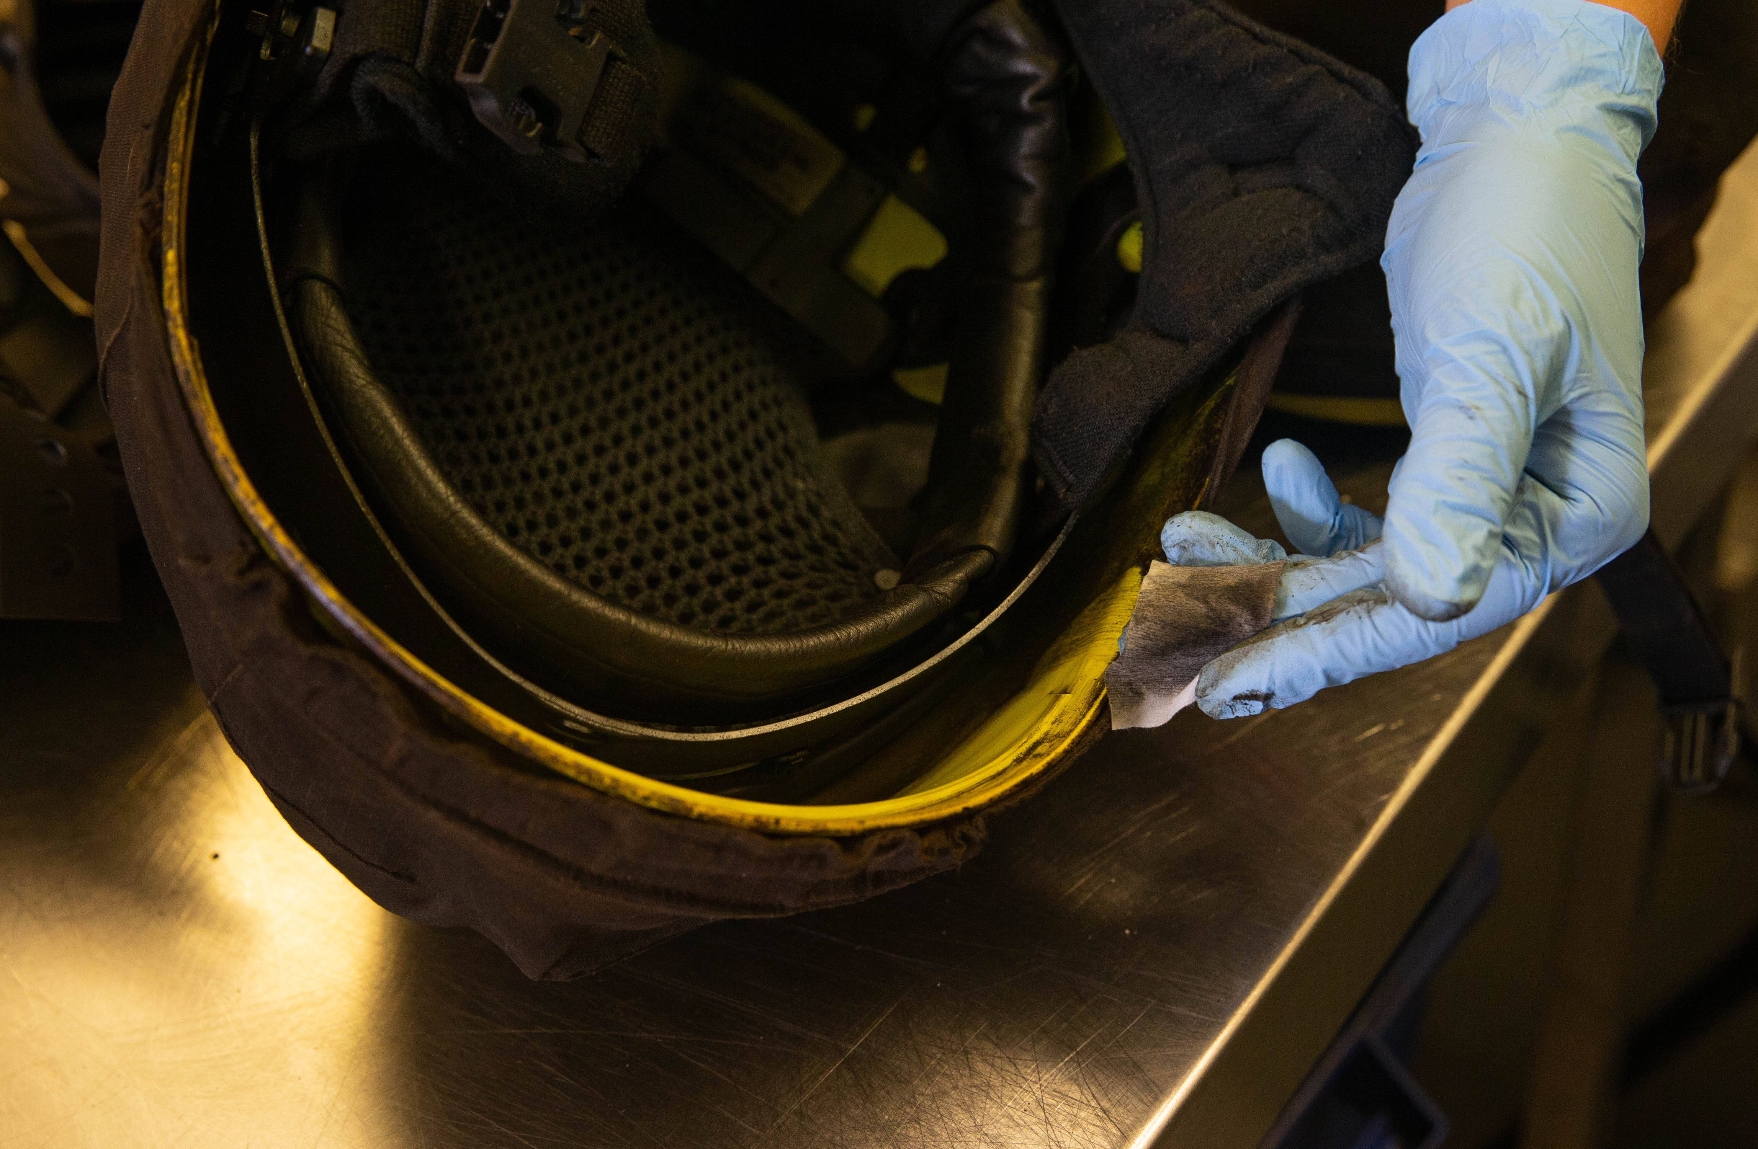
CURRENT SITUATION IN THE UK FIRE AND RESCUE SERVICE
No UK standard or requirement for prevention or mitigation
No Presumptive Legislation
No Health Monitoring

Slide 3
PRESUMPTIVE LEGISLATION
The legal requirements for prescription are set out in The Social Security Contributions and Benefits Act 1992 which states that the Secretary of State may prescribe a disease where s/he is satisfied that the disease:
a. ought to be treated, having regard to its causes and incidence and any other relevant considerations, as a risk of the occupation and not as a risk common to all persons; and
b. is such that, in the absence of special circumstances, the attribution of particular cases to the nature of the employment can be established or presumed with reasonable certainty
Thus, a disease may only be prescribed if there is a recognised risk to workers in an occupation, and the link between disease and occupation can be established or reasonably presumed in individual cases.

Slide 4
THE ROLE OF THE INDUSTRIAL INJURIES ADVISORY COUNCIL
IIAC is an independent statutory body established in 1946 to advise the Secretary of State for Social Security on matters relating to the IIDB scheme. The major part of the Council’s time is spent considering whether the list of prescribed diseases for which benefit may be paid should be enlarged or amended.
The Council thus looks for evidence that the risk of developing the disease associated with a particular occupational exposure or circumstance is more than doubled

Slide 5
THE ROLE OF THE INDUSTRIAL INJURIES ADVISORY COUNCIL
In 2008, 2010 and most recently in 2021, IIAC determined that they did not find consistent evidence that the risk of any type of cancer is more likely than not to be due to firefighting
IIAC have not reviewed their position since the IARC categorisation 2022

Slide 6
FBU RESEARCH
In 2018, the FBU commissioned the University of Central Lancashire (UCLAN) to carry out the biggest study into Firefighter Cancers ever carried out in the UK.
Funded by the FF100 Fund
UK wide literature review
Survey of over 11,000 serving firefighters
Workplace & PPE testing

Slide 7
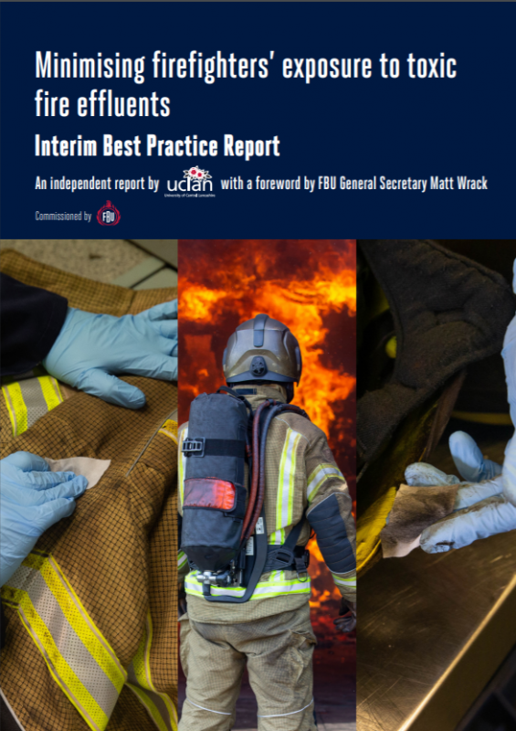
INTERIM BEST PRACTICE REPORT MINIMISING FIREFIGHTERS’ EXPOSURE TO TOXIC FIRE EFFLUENTS
Toxic fire effluents directly linked to increased rates of cancer among firefighters
More than 4% of survey respondents found to have a cancer diagnosis
Instances of cancer among firefighters aged 35-39 were up to 323% higher than in the general population in the same age category.

Slide 8
SCOTLAND RESEARCH
Type of cancer | Mortality rate
Unknown origin | 6 x higher
Prostate | 3.8 x
Leukaemia | 3.2 x
Without specification of the site | 2.7 x
Oesophagus | 2.4 x
Urinary system | 1.9 x
Firefighters have higher mortality rates for certain cancers: A A Stec, A Robinson, T A M Wolffe, E Bagkeris, Scottish Firefighters Occupational Cancer and Disease Mortality Rates: 2000-2020, Occupational Medicine, 2023; kqac138

Slide 9
FIREFIGHTERS CANCER AND DISEASE REGISTRY

Slide 10
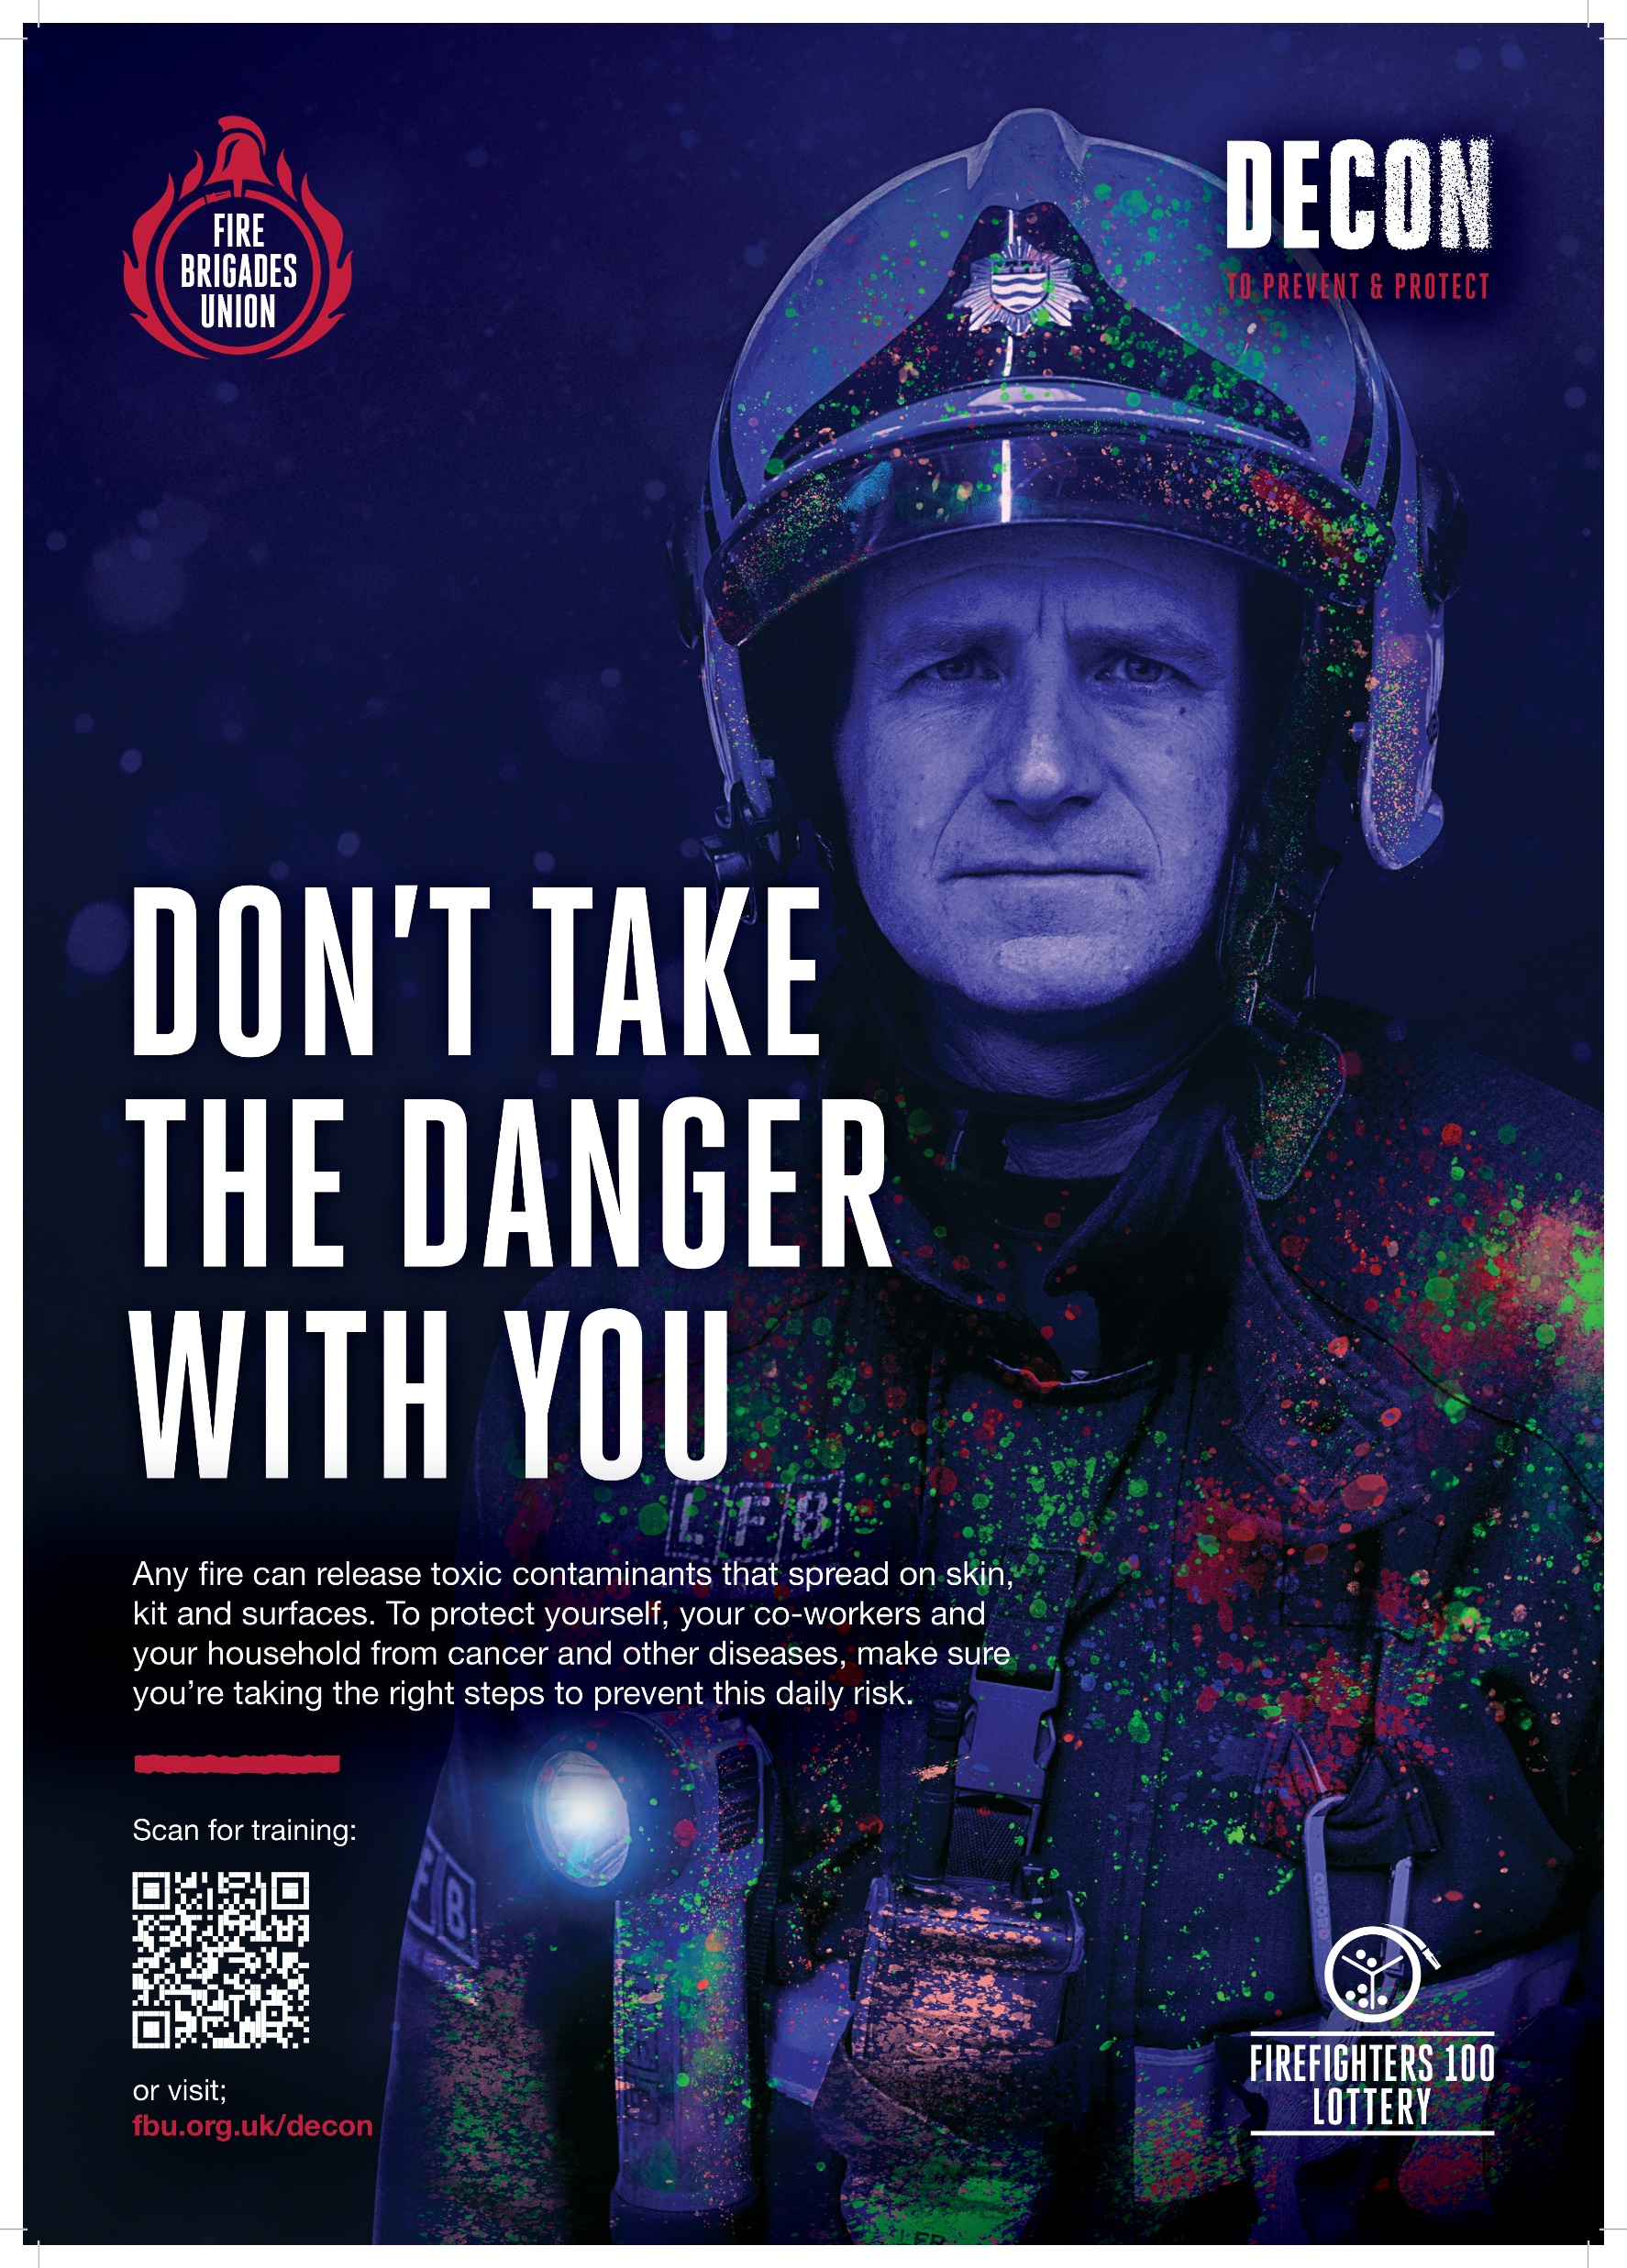
DECON CAMPAIGN
The FBU launched the DECON Campaign funded by the Firefighter100 Lottery, including:
Training packages
Awareness resources
Translation and adoption of UCLAN best practice into languages across Europe (through the EPSU Firefighters Network)

Slide 11
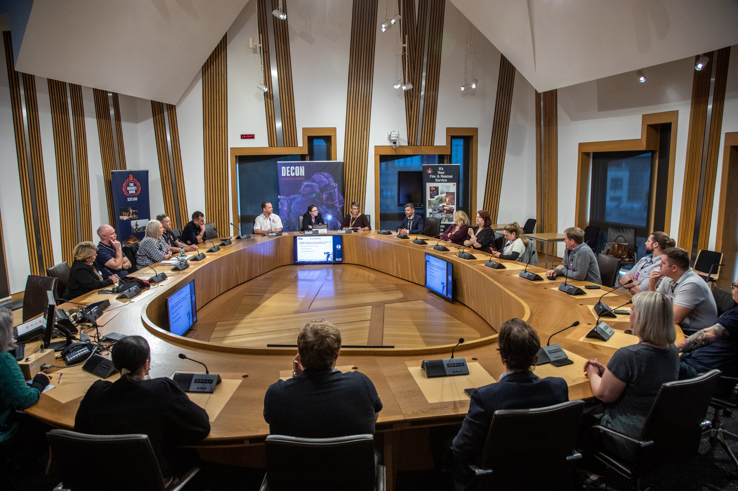
DEMANDS
UK wide Prevention Strategy – To mitigate and eliminate exposures
Health Monitoring – Annually and to continue into retirement
Presumptive Legislation – To provide the financial and medical support need for firefighters and their families

Slide 12
WHAT HAVE WE ACHIEVED?
Awareness resources now found on nearly all fire stations in UK
Introduction of DECON & Clean Cab Policies
Reviews of Cleaning contracts and station design
Debates in Northern Ireland Assembly, Scottish Parliament & Westminster APPGs
Health & Safety Executive review into decontamination policies
Firefighter Cancer & Disease Registry

Slide 13
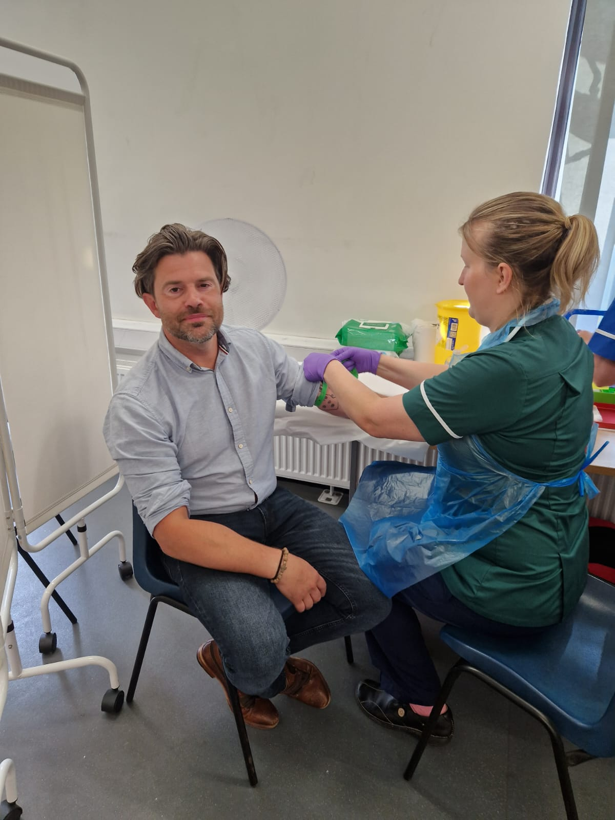
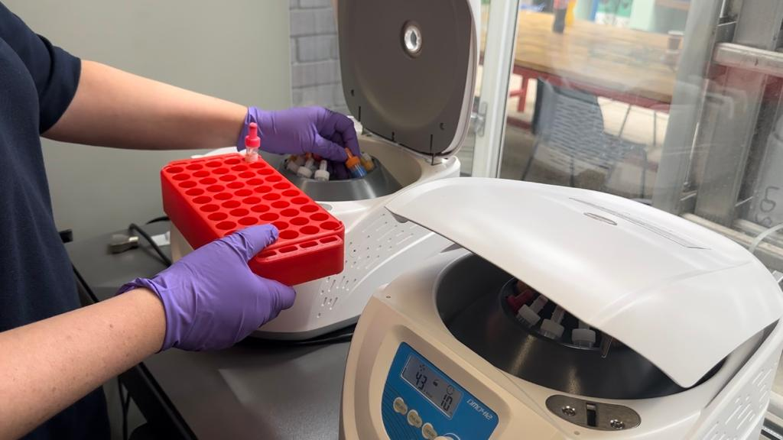
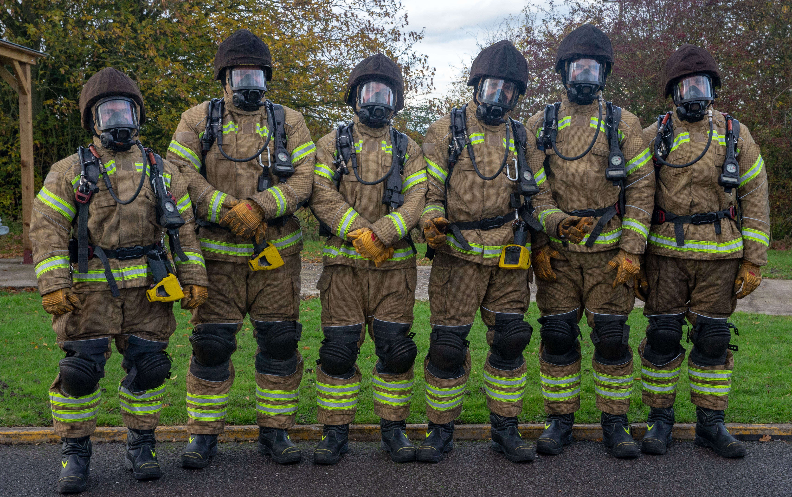
NEXT STEPS
UK Health monitoring project
PPE Testing
Lobbying for IIAC review of occupational diseases

