Slide 1
Healthier Firefighters Today:
Evidential Approaches to Effective Decontamination
Brett Egan-Briers

Slide 2
Timeline
McMasters Study - 2013
CAST Report – 2018
BS 8617 - 2019
UCLan (FBU) Interim Report - 2020
IIAC Position Paper No. 47 – 2021
UCLan final reports – 2023
DECON (FBU) - 2023
WHO (IARC) Classification - 2023

Slide 3
What’s happening currently
UCLan (and other) research
HSE engagement and research
NFCC Contaminants group
Standards
Raising Awareness:
The Invisible Risk Conference/Survey
Particulate Protection & Decontamination Seminar (Biggin Hill)
Firefighters Podcast
Evidential Approaches to Effective Decontamination

Slide 4
Health and Safety Executive
Various fire service site visits
Decontamination of structural fire kit
Stage 1 – Literature review (completed)
Stage 2 – Testing
25 sets including gloves and fire hoods

Slide 5
NFCC Contaminants Group
Established Feb 2023 by Health and Safety Committee
Nine work packages:
Literature Review (plus Home Office led Decontamination review)
PPE (NFCC PPE and Clothing)
RPE
Risk Assessments
Appliances and Equipment
Training and Competence
Estates
National Guidance/Fire standards
Health Surveillance

Slide 6
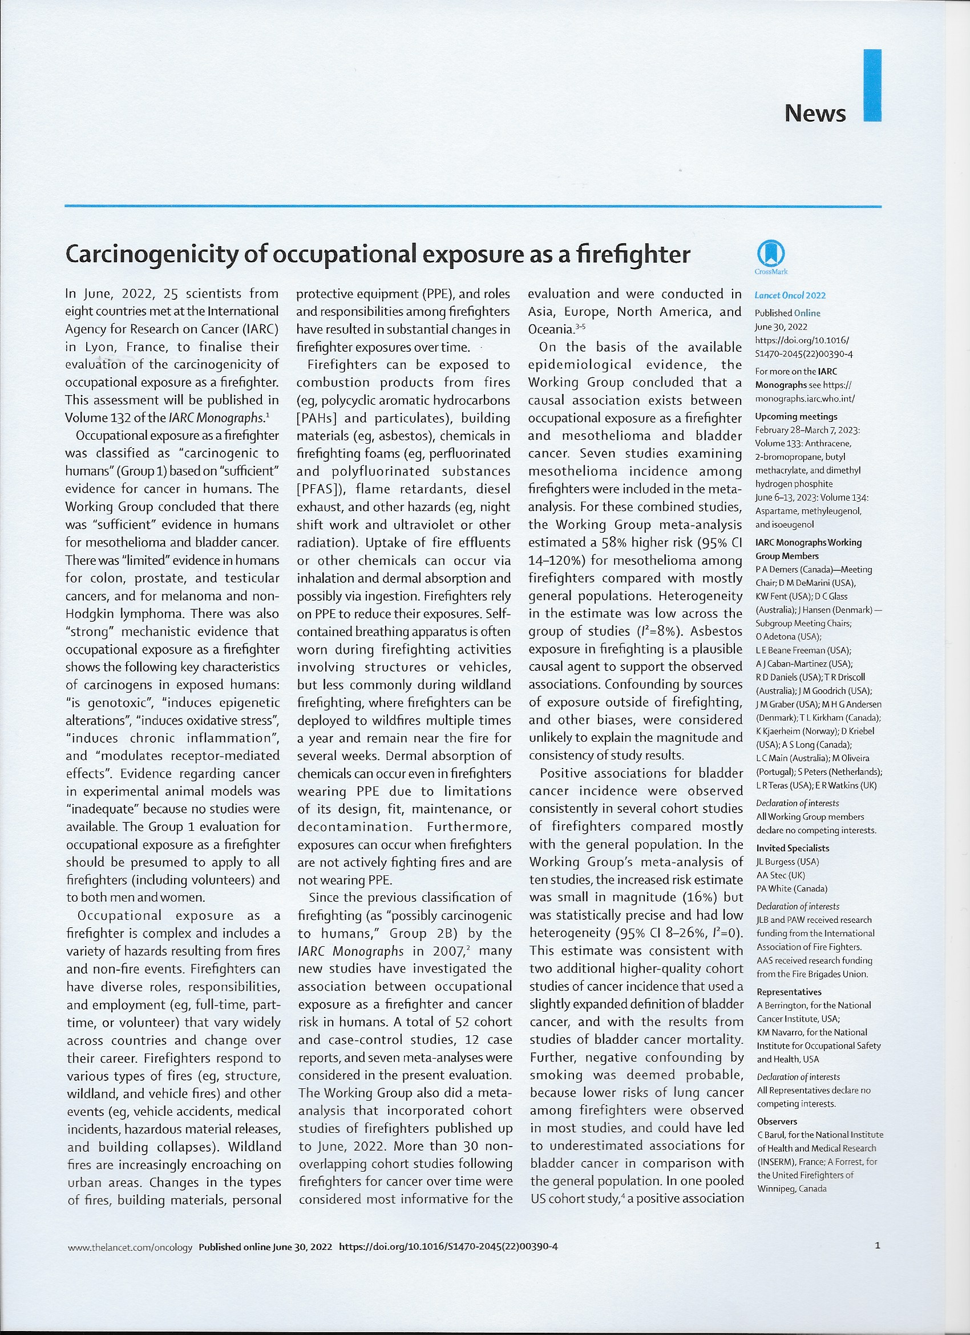
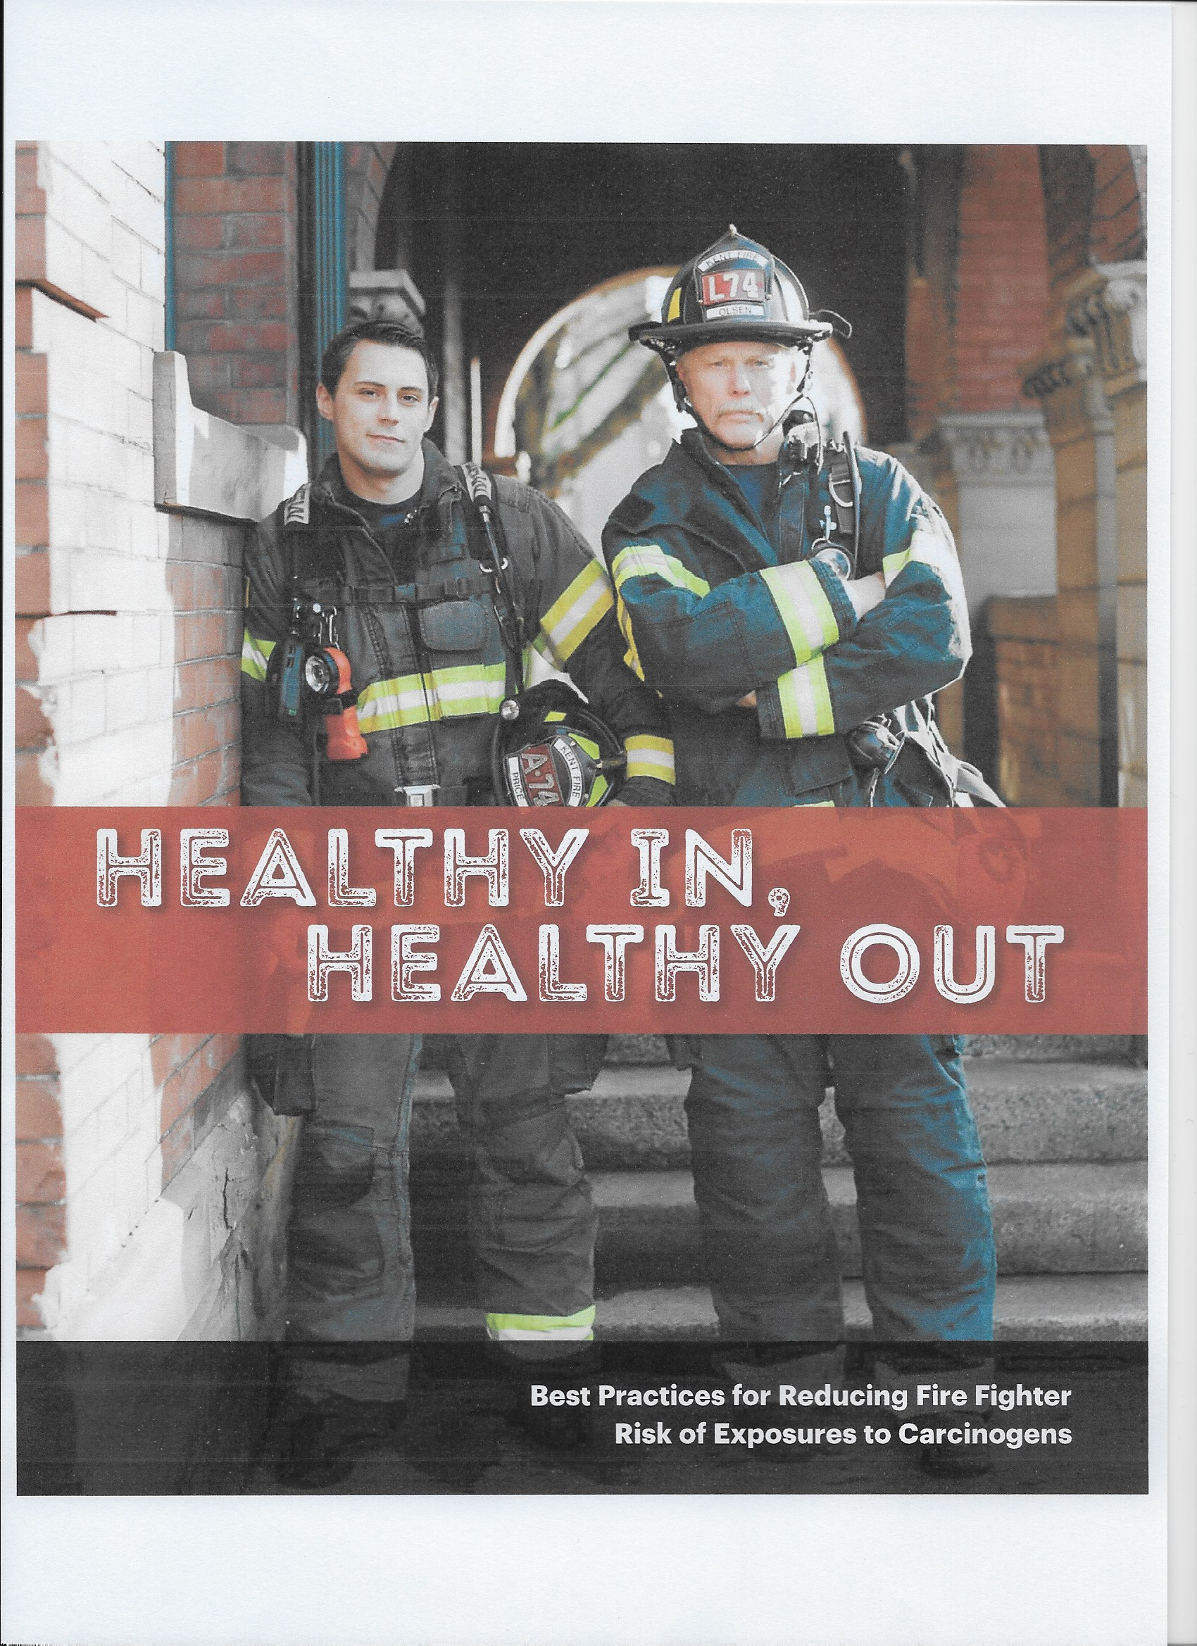
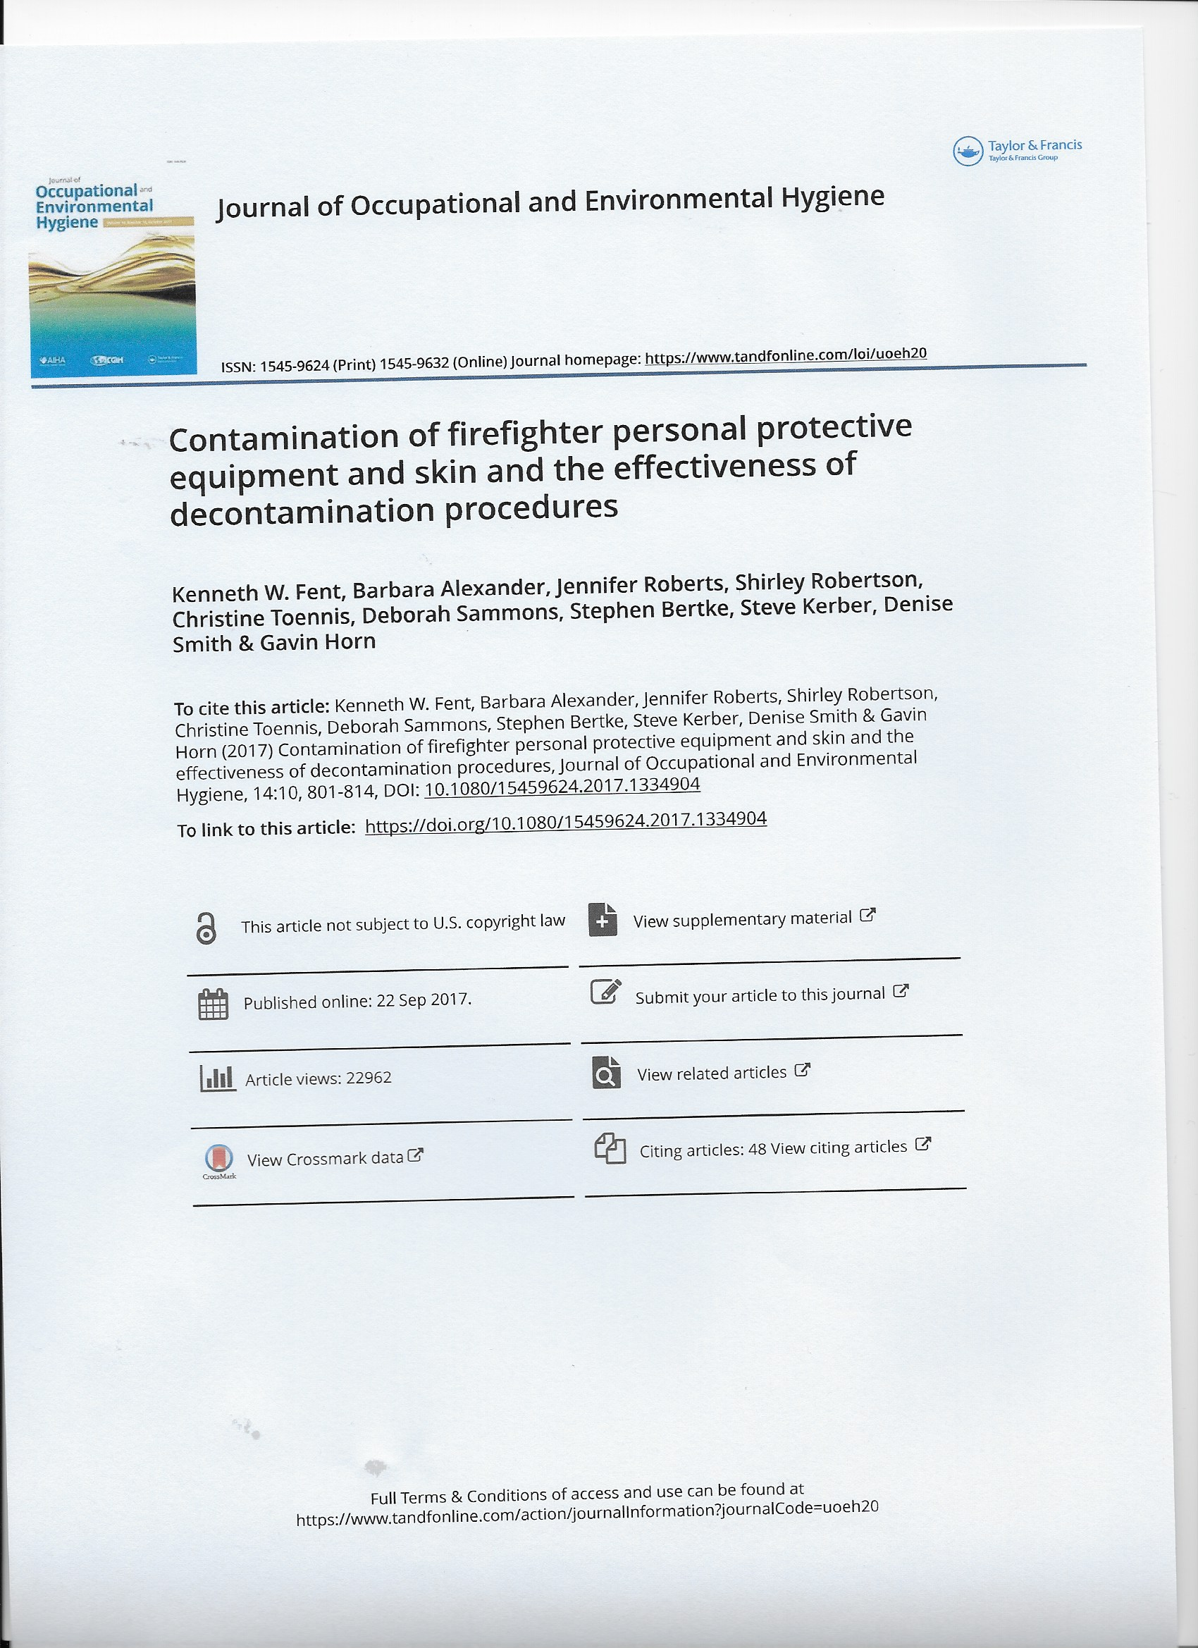
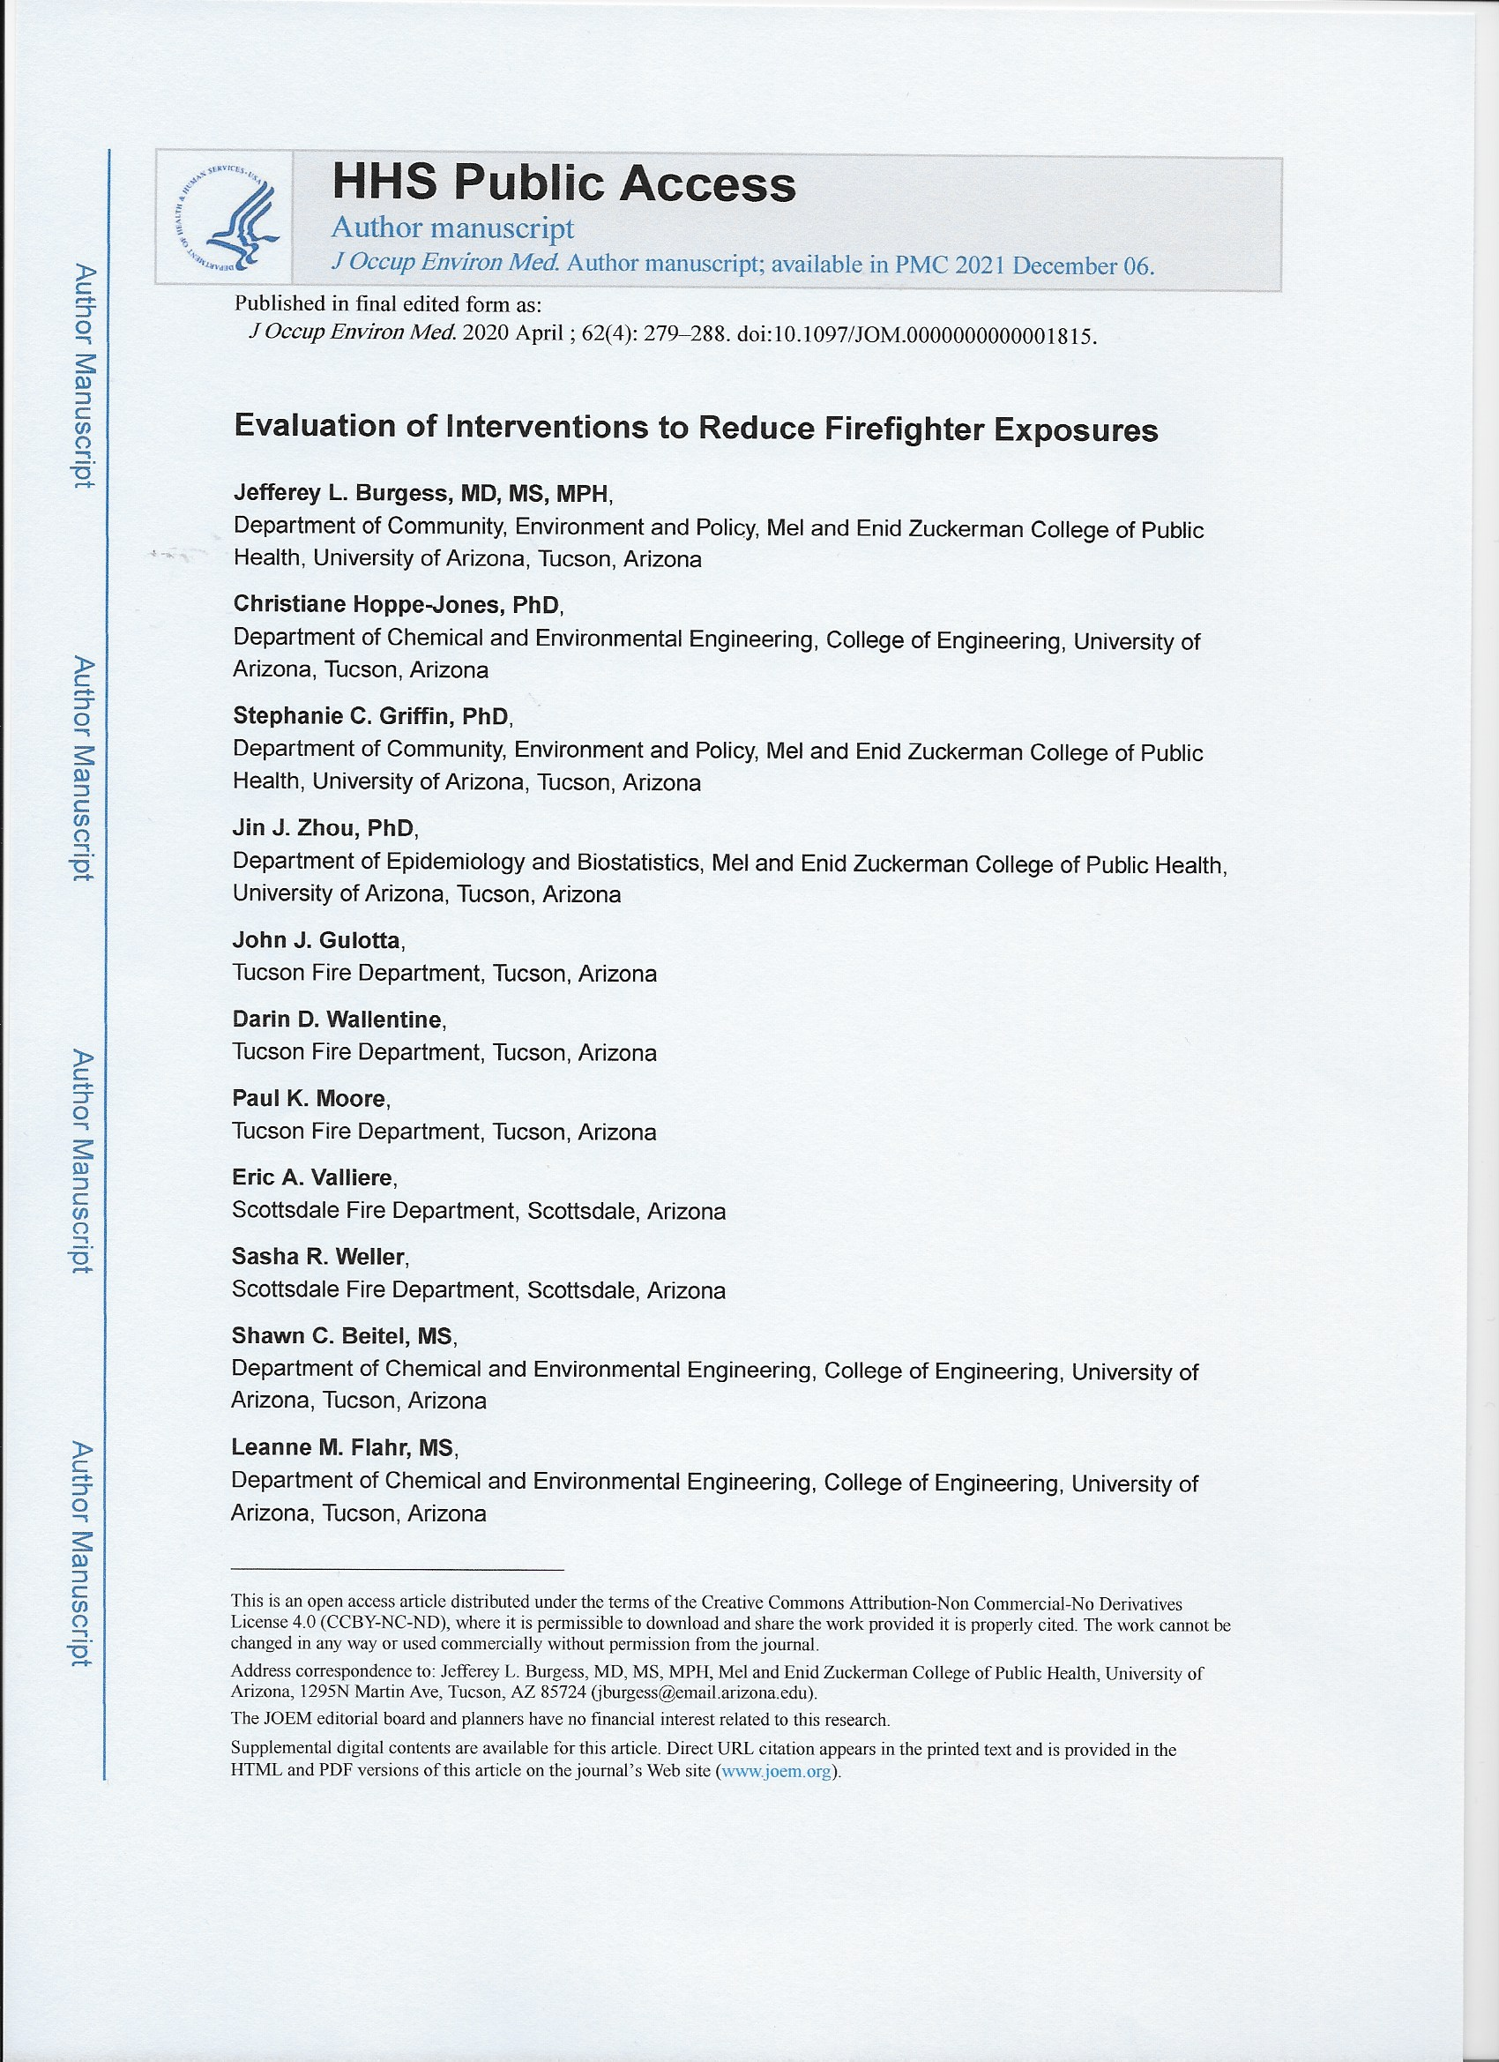
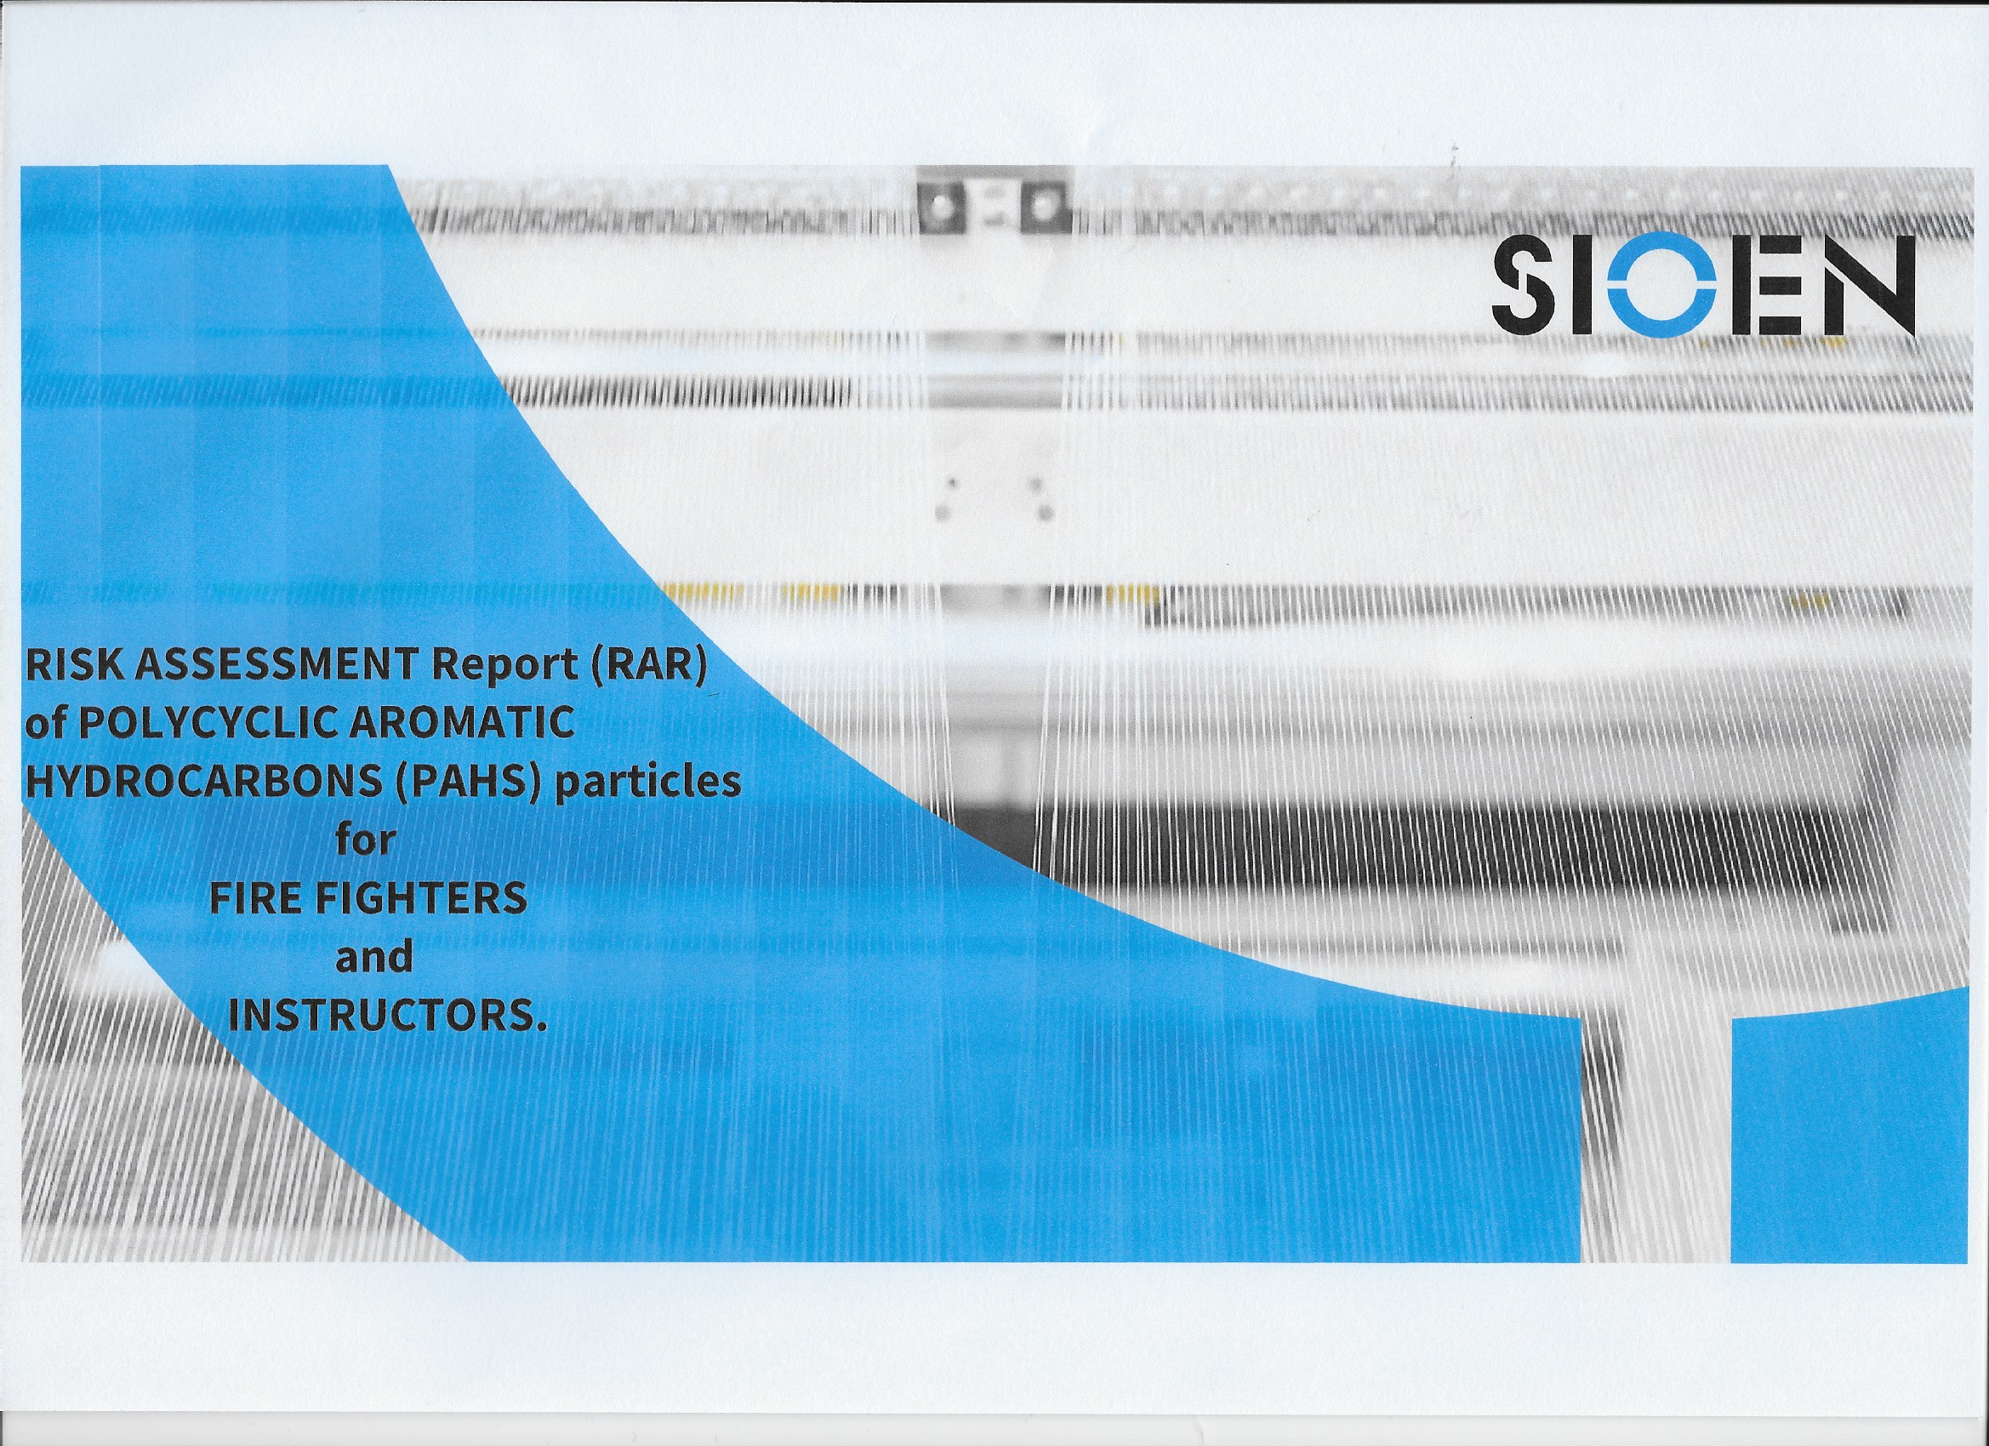
Literature review
150 articles and reports:
125 scientific papers and 25 reports
49 of the papers were included in the IARC review
64 papers from 2022 and 2023 (only 4 of these included in IARC review)

Slide 7
Standards
 | CEN |  | ISO
Helmet | BS EN 443:2008 |  | BS ISO 11999-5
Fire Hood | BS EN 13911:2017 |  | BS ISO 11999-9
Tunic/trouser | BS EN 469:2020 |  | BS ISO 11999-3
Fire Gloves | BS EN 659:2003 |  | BS ISO 11999-4
Fire Boots | BS EN 15090:2012 |  | BS ISO 11999-6
Rescue Jacket | BS EN 16689:2017 |  | BS ISO 18639-3
Wildland | BS EN ISO 15384:2020
Hi Visibility | BS EN ISO 20471
Rescue Gloves | Various non-specific (prEN 659) | BS ISO 18639-4 | BS ISO 18639-4
Cleaning and Maintenance | n/a | BS ISO 23616:2022 | BS ISO 23616:2022

Slide 8
How Clean is Clean?
Research Foundation project - PPE and Fire Service Gear Cleaning Validation (nfpa.org)

Slide 9
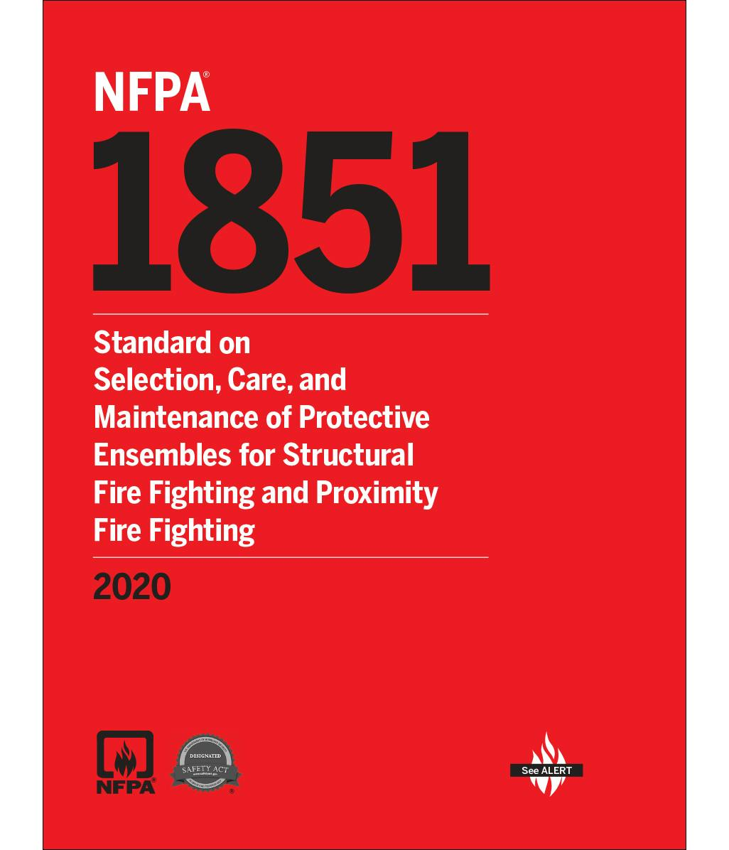
NFPA 1851 (under revision)
Annual independent verification
50% Volatile organic compounds (VOCs)
50% Heavy metals
99.9% bacteria and viruses

Slide 10
Changes to expect in the cleaning process
50% now 70%
40°C now 50°C
<60 ppm Ca & Mg
Laundering efficacy for certification
Laundering temperature
Water softening may be required

Slide 11
Laundering Efficacy for ISP Certification
PAH, Phenols, Phthalates
Metals
Bacteria
Acenaphthene (PAH)
Anthracene (PAH)
Diethyl phthalate (Phthalate)
Di-n-octyl phthalate (Phthalate)
Fluorene (PAH)
Phenanthrene (PAH)
Pyrene (PAH)
2-Nitrophenol (Phenol)
Phenol (Phenol)
2,4,6-Trichlorophenol (Phenol)
Benzo[a]pyrene (PAH)
Benzyl butylphthalate (Phthalate)
Antimony
Arsenic
Cadmium
Chromium
Cobalt
Lead
Klebsiella pneumoniae
Staphylococcus aureurs

Slide 12
Laundering Temperatures
Removal at Current 40°C
Removal at New 50°C
Specialized 60°C
Anthracene – 44%
Di-n-octyl phthalate – 17%
Fluorene – 66%
Phenanthrene – 41%
Benzo[a]pyrene – 21%
2,4,5-Trichlorophenol – 72%
Chrysene – 21%
Anthracene – 92%
Di-n-octyl phthalate – 27-36%
Fluorene – 99%
Phenanthrene – 64-69%
Benzo[a]pyrene – 83-84%
2,4,5-Trichlorophenol – 83-91%
Chrysene – 40-45%
The act of removing hazardous materials, soiling associated with body fluids, or other forms of contamination that require special attention or handling either due to the hazards imposed by these substances or the need for unique techniques for their removal.
Specialized Cleaning should be done when ensembles are exposed to the decomposition products from fires that involve mobile or stationary energy storage systems.
J. Tarley, L. Greenawald, C. Forester, J. Stull

Slide 13
Asbestos? (Mesothelioma)
Mesothelioma - 58% higher risk
Bladder cancer – 16% higher risk
Limited evidence:
Colon cancer, prostrate cancer, testicular cancer, melanoma of the skin and non-Hodgkin lymphoma

Slide 14
Asbestos
04/12/2023
The OEL was lowered from 0.1 to 0.01 fibres per cm³ by amending Directive 2023/2668/EU. Member States are required to enforce this lower exposure limit starting from 21/12/2025.
Furthermore, by 21/12/2029, the OEL must be further reduced.
Directive 2009/148/EC - exposure to asbestos at work | Safety and health at work EU-OSHA (europa.eu)

