Slide 1
Fire Contaminants ‘Healthy in healthy out’– London Fire Brigade
Version 1.0
Notes:
Introduction.

Slide 2
Fire Contaminants ‘Healthy in healthy out’– London Fire Brigade
Version 1.0
Notes:
Introduction.

Slide 3
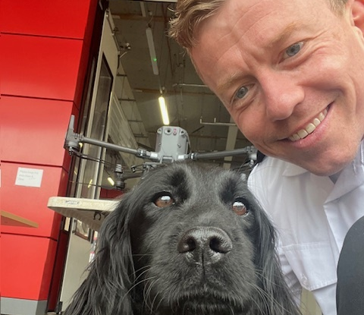
Biography / Disclaimer
2004 MChem Chemistry Degree
2004-07 Scientific Advisor LFB
2007 Joined LFB Operational Fire Fighter
2022 Joined – Operational Assurance- Hazmat Department - fire contaminants
Disclaimer – The LFB do not offer endorsements of manufactures. LFB willingly will, assist and discuss.
Notes:
Read slide

Slide 4
Whistle stop tour – Fire Contaminants
World Health Organisation July 2022 declared fire fighters' occupation as carcinogenic. This is the highest rating.
There was “sufficient” evidence of carcinogenicity in humans for mesothelioma and cancer of the bladder and “limited” evidence for cancers of the colon, prostate, and testis, and for melanoma and non-Hodgkin lymphoma.
Recognised that firefighters are contracting a variety of illnesses such as cancer earlier and at a greater frequency than the general population.
However - There are additional factors to consider such as diet, weight, working shifts and genetics which can affect an individual’s potential to contract cancer or other associated illness owing to bad diet and lack of physical exercise.
Notes:
Read slide.

Slide 5
Recent developments (2)
UClan and FBU research suggest evidence of high risk from prostrate, leukaemia and oesophageal cancers. Also suggest cancers are contracted earlier and more likely to spread than in the general population and increased risk from stroke and heart attack additionally.
Waiting on more research from blood survey from UClan which the LFB were active participants.
The risk from female cancers is under documented owing the nature of the survey.
American research looking into the development of cancers comparing fire fighters with general population provide a link to occupational exposure.
On going research HSE inspecting FRS into response to minimising fire contaminants risk , Home office research and NFCC cancer risk
Notes:
Read slide
More of a point of interest, when comparing to the American research, is there any recognition to how the UK and America use BA differently? UK have a ‘start up in clean air’ policy whereas America go into fires and only put the BA set on when they encounter smoke

Slide 6
Fire Contaminants - Phase 1 - Achievements
One of first specific policy in UK surrounding fire contaminants.
Video training.
Increased awareness of fire contaminants and potential health effects.
Importance of PPE,RPE at incidents and use of gas detection monitors.
The importance of separating and or cleaning operational equipment introduction of zonal areas at stations, polythene and how they limits the spread of fire contaminants in the fire station.
Shower within an hour of returning to station.
Fire contaminants box on appliance.
Notes:
Read slide content for further information..
The 13 points that should be adopted by for fire personnel and recommendation for fire service across the UK. The LFB/HMEP team have opted to deliver this change in a two-phase approach. There has been no cost associated to the UCLAN report or research. Phase 1 has result in little or no cost to the authority.
This policy has been developed and agreed at FBU. This policy will develop over time as equipment and research improves. LFB have managed the risk to get the education and policy out to stations and are one of the first FRS to do this. Phase two and three will see further changes on the incident ground and at station and address the implications.
You will see significant changes to policies 466 BA and 956 Respirators.

Slide 7
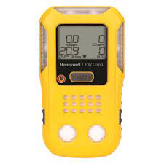
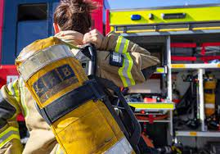
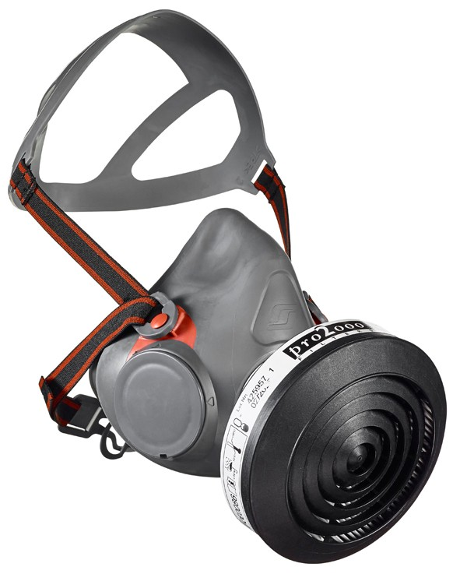
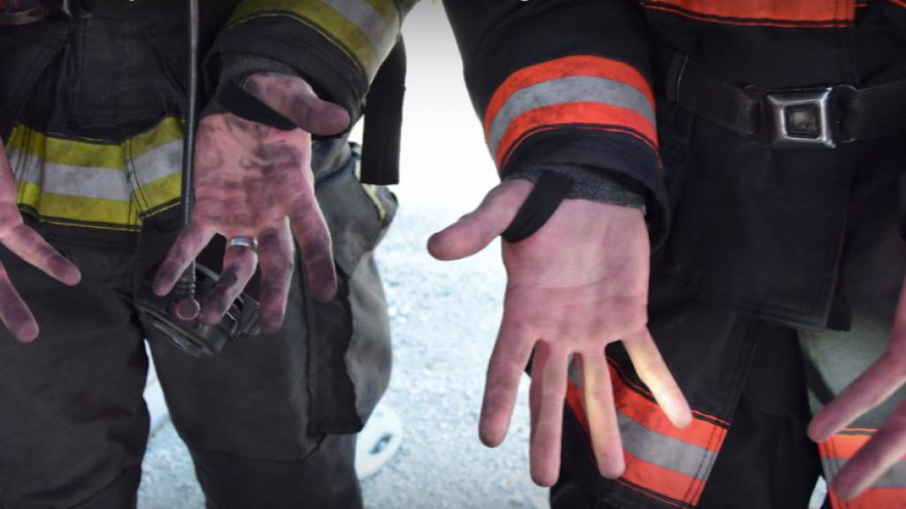
Responsibility and equipment
.
Notes:
Equipment available initial incident
Aide Memoire
PVC bags for bagging up BA sets, PPE800x1000mm
Brush from dustpan set
Washing up liquid 450ml (Low foaming detergent)
Ultragrime wipes - 1 for contaminants box and 1 for appliance cab area)
Large nitrile gloves
Bin liner 30-40L
Respirator tallies - (Reuse existing tallies from filter box)
However, this does not mitigate the need for showering within an hour.

Slide 8
Driving Change
LFB decided to address the fire contaminants approach in multiple phases.
Address negative aspects of fire contaminants policy
Mitigate the reputational damage by not managing the risks
Reduce the exposure risk to staff from fire contaminants other carcinogenic material and the subsequent potential illness.
Reduce the risk to communities and the families of staff by preventing cross-contamination into fire stations, workplaces, and homes.
Lessen the impact of those listed in the equalities impact assessment, which could show that certain ethnicities suffer from high rates of cancers.
Notes:
This presentation proposes to address: the negative operational impacts of the policy and increase the mitigation of risks posed by fire contaminants and carcinogenic material exposure. This will protect the authority for years to come and reduce the potential of reputational damage by not managing the risks posed by fire contaminants and firefighting foam. This is the biggest change to how the LFB operate since the procurement breathing apparatus by changing the way we manage PPE and breathing apparatus.

Slide 9
Key learning
Managing the biggest changes since the introduction of breathing apparatus. What does the future hold firefighting?
Communication – Continuity of message consistent organisational message
The mountain of research – Literature review- what is reliable?
Increase success – through joint working and collaboration.
Training, enforcement and control incident ground - When does “should become” or “require to” and “then must”. Behaviours are hard to change without organisational support.
Has the policy been stress tested – Are you creating further risks?
Consider budget ring fenced and record meetings for accountability purposes.
Notes:
You are all managing the most significant change since the introduction of BA. The change will not happen all at once.
Fire contaminants is emotive it is important that there is a consistent voice and source of repuitual information.
There is vast amount of research some reliable some not. Its important to sift through these. NFCC and Home office are producing reports soon to be published.
Collaborative working - FBU, surrounding fire services management stake holders, equality support groups will improve product surrounding fire contaminants.
The success of the policy is through enforcement – required to should do and must do. Legal and non-legal reasons.
There needs to be a level of accountability for the decontamination role and assurance. To improve situational awareness
Has the policy been stress tested – London are lucky with resources other county brigade don’t have this luxury.
Ring fencing budgets to assist with deliverables.

Slide 10
Key Points? - What is the definition of done?
Who is affect the most? Through exposure FF – FI – FBT - Public
What is the risk appetite of the service?
What is unknown? PPE protection/ exposure levels
What is the greatest bang for buck reduction of fire contaminants, with tightening budget?
Is the UK currently aligned with other FRS across the world?
Does answering one fire contaminants question, consequently, ask five more or a further risk? Incident command
Are you providing proportionate risk control? Still have a job to do? – Future Fire fighter
Notes:
The staff exposure, trainers, fire fighters, methods of exposure (inhalation/ingestion/demeral), transient or significant exposure these are all down to the interpterion of the individual.
How do we understand this risk further – fire logs or exposure records.
The risk appetite and what an FRS? If you purchase an item what is the impact if it’s the incorrect decision. Purchase of BA wash plants can they be leased or purchased? Do you have the resources to accomplished what was set out in UClan report. There is a balance between science and operational role and common sense approach.
There is a FOG and raft of research out there and some is reliable and some equally may not be. An example of this is what does PPE do currently in the protection of contamination from carbonaceous wears.
Is there an alternative motive for manufactures and supplier to sell items backed by research are they independent?
Is the country aligned with the rest of the world? Simple answer NO.
With the fire contaminants policy do you create further risk whether this disrobing and reducing number of personnel on the incident ground or protecting people from fire contaminants great a greater risk with heat stress. We have exemptions to this policy for life risk.
We must provide proportional risk control measures – we still have a job to and cannot completely reduce exposures to zero and no forensically clean.

Slide 11
Fire Contaminants - Phase 2
Research - Funding to support University Research to investigate fire contaminants
The areas of work have been broken down to role, incident ground and fire stations/property owing to who they effect most.
Fire Fighter
1. Breathing apparatus log of wear through a computer database system
2. Health Screening
3. Storage of PPE - Senior Officers Vehicle’s
Personal bags
Welfare – Cancer awareness
Notes:
Further research and testing into fire contaminants
Funding is required to be set aside for collaborative working with universities such as Brighton, UCLAN and Hertfordshire or other specialist bodies (Scientific Advisors-Bureau Veritas-BV).
BV has already provided some goodwill consultancy on this topic, but the extent of this work could mean an extra cost.
This may include sponsoring undergraduates to complete projects on behalf of the LFB or Nationally through the NFCC working group which may prove value for money so that work isn’t needlessly repeated between other fire rescue authorities.
Funding may be required to verify some findings from Prof Anna Stec for specific LFB equipment. An example of this is the extent of contamination to workwear which has been justified by a US science paper and ideally tests should be performed on LFB PPE.
There ultimately needs to be a balance of academic science findings and what is reasonably practical and that element of risk from exposure which cannot be eliminated in its entirety and proposed changes will result in a significant cost to the authority. The solutions and recommendations and their suitability for a regional or metropolitan fire service may vary such as the frequency or simultaneous incidents.
Any research will also need support from MSA/Drager/Bristol manufacturers to support the testing. Testing used PPE and Respiratory Protection Equipment will have too many variables to consider, for example, the history of the fire kit and its exposure to fire contaminants and the firefighter actions in the compartment would not have been consistent. These will be important factors when procuring or evaluating any cleaning performance of new equipment such as wash plants.
A consequence of this could mean additional costs with procuring items for testing unless the manufacturers are happy to provide items for free provided in exchange for sharing research findings.
The interested stakeholders that are directly affected by the policy and scientific findings, should make their decisions based on scientific work and a cost-benefit analysis where possible. This is owing that one day it may be required in a court of law and protects the fire fighter and authority as a whole.
Areas of consideration for research are listed below.
These is not exhaustive and subject to full literature using a qualified person and method.
Literature search into Decontamination – Fire contaminants
Potential New PPE testing, permeability to fire contaminants – particle flash hood. PPE’s permeability versus different chemicals/effluents versus age/use/damage
Investigating efficiency of the cleaning process of structural PPE
‘Off gassing’ PPE and scene– air quality testing. (Some air quality has been conducted by the SA and health safety department)
Exposure research of LFB fire fighters use of silicon bands reference- https://www.sciencedirect.com/science/article/pii/S0048969722023300?via%3Dihub
Looking at scientific data and the absorption of fire contaminants to the body through the hair and skin – Hertfordshire University
Decontamination effectiveness – Hertfordshire University
Fact finding – or procurement testing of BA wash plants and hose wash facilities
Extent of fire contamination to workwear investigate whether new or update workwear is required
Firefighters exposure to fire effluents: dermal versus inhalation intake (validate and implement methods developed by Haz (skin permeability for different chemicals) -but in relation to firefighters’ dermal exposures
Validate dermal intake versus inhalation (high rise building exercise with the firefighters or wildland/peat fires). Understand better exposures (and dominance) and decontamination methods (with biological testing)

Slide 12
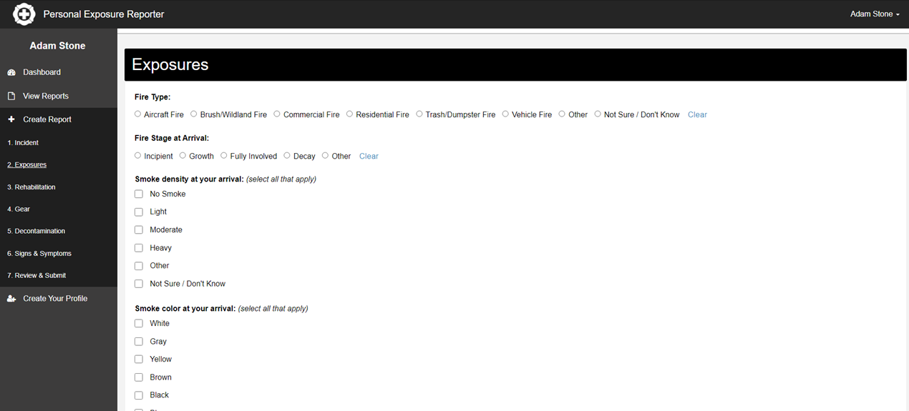
Breathing apparatus log database system
Notes:
Recording of BA wears –There is no accurate way of recording the BA wearer exposure record, conditions and any actions performed for example search and rescue, firefighting /ventilation and whether the firefighter performed decontamination at the scene.
The new MSA breathing apparatus sets only record breathing rates, they do not cover conditions or activities on the fire ground. There is development work on going to develop the fire grid with MSA. If there is any presumptive legislation and legal claims this could assist in protecting the LFB against future claims.
This will be ideal for managing exposure to fire contaminants record and is directly related to health screening which is discussed in more detail below any potential presumptive legislation or legal claims against the LFB.
This could be in the form of a database or part of the new BA set integration project or created internally by the IT department.

Slide 13
Scan the QR or use link to join
https://forms.office.com/e/7xFgCvRT51
My Fire LOG - 2024 Record your BA Wear and Fire Events Record 4-5 minutes to complete and accessible on computer or mobile.
https://forms.office.com/e/7xFgCvRT51?origin=lprLink
Notes:
This a draft example of what an exposure log may look like and LFB are considering. In conjunction with the LFB Union section and fire contaminants working group.

Slide 14
Health Screening
The LFB currently provide Mental health
Blood Pressure
Asbestos survey
Glucose
Hearing function test
Cholesterol test
Body mass index
Lung function
Kidney function – Urine Protein test
Drug test
*There is also a separate physical test.
Notes:
Health screening – The evidence of increased cancers and other health effects can be found in documents as listed in the scientific evidence from the University of Central Lancaster.
IARC document shows that FF’s are at an increased risk of regarding mesothelioma and bladder cancers document 1 July 2022. https://www.google.com/url?sa=i&rct=j&q=&esrc=s&source=web&cd=&cad=rja&uact=8&ved=0CAQQw7AJahcKEwiov9L46N38AhUAAAAAHQAAAAAQAg&url=https%3A%2F%2Fwww.iarc.who.int%2Fnews-events%2Fiarc-monographs-evaluate-the-carcinogenicity-of-occupational-exposure-as-a-firefighter%2F&psig=AOvVaw1aHFST_Txqi-cJ9UghslJS&ust=1674567666357310
The LFB currently provide a basic medical very three years at a cost of £180 from a third-party provider. This includes the following.
Mental health
Blood Pressure
Asbestos survey
Glucose
Hearing function test
Cholesterol test
Body mass index
Lung function
Kidney function – Urine Protein test
Drug test
*There is also a separate physical test – Chester treadmill test.
The risk surrounding fire contaminants appears to have a similar connotation to asbestos with the identification of the risk and potential legal ramifications.
The current routine period medicals do not consider the risk of fire contaminants. A significant development in the medical services it provides to firefighters and retired members owing to that there is a known and potential latency period of cancer development and post-exposure.
Note - This should have oversight from a medical professional to peer review these suggestions and make a strategic decision to ensure that firefighters receive the correct screening and support/care using the current technology available.
This is one of the most important aspects of managing the risk from fire contaminants is early detection of illness, whether for treatment or to make lifestyle changes which could reduce their risk. This would improve morale, make the LFB a more attractive option for employment, addresses the issues of increased cancers within certain ethnicities and reduce the cost impact from sickness and the potential of legal claims.
See evidence of this https://awhsolicitors.co.uk/articles/industrial-disease/fire-fighter-compensation-claims/
LFB should have full medical at the start of employment to provide a baseline of findings. The logistics of providing medicals to 4500 firefighters within a metropolitan fire service annually as recommended by the scientific papers may not be possible owing to the cost impact of decreasing the intervals between medicals & improving the medical will only increase the cost further. Welling department should not rule out a biannual medical and look into the implications costs. For smaller county authorities this may be more practical owing to naturally the smaller workforce.
The way medicals are managed could be made upon a risk-based approach and how often a firefighter is exposed to carbonaceous materials but also other variables such as age and length of service criteria. Not every firefighter will have the same occupational exposure or attend the same type or number of incidents this could vary significantly depending on station and location within London. However, a firefighter could attend one specific incident such as Grenfell where all personnel should be monitored owing to the nature of the incident. This is also as specified within National Operation Guidance as a control measure. Exposures/BA wears should be recorded through a BA database or IMS recording system as mentioned previously.
The LFB need to consider that they have many non-operational staff and contractors who have the potential to be exposed to fire contaminants through their role in particular OSG, fire engineers, fire safety and fire investigation. The scientific report does not take into account this demographic of individuals, but a record should be kept of exposure, routine periodic medicals, PPE and training are given.
The easiest option would that all operational staff and support staff that are exposed to fire contaminants get medical screening which would result in a significant cost to the authority. Cost - TBC
Ethically all additional tests that are proposed should be completely voluntary, where a positive result or a diagnosis such as cancer the LFB could then dissolve the responsibility to their GP/NHS for medical care and offer support through mental health and well-being.

Slide 15
Future Health ?
Heart –electrocardiogram EGC
Blood test for kidney, liver function and full blood count
HBa1C diabetes test - Show an increased risk of cardiovascular disease
QRisk3 – Is used by enable doctors identify those most at risk of heart disease and stroke within the next 10 years.
PFAS and PFOS specific blood test
Multi Cancer Screening
Notes:
Proposed medical screening – Could involve the following.
Heart –electrocardiogram EGC – Could look for potential heart issues and risks combined with other lifestyle factors heart attack and stoke
Blood test for kidney, liver function and full blood count – Can be used screening general health monitoring a reduction full blood count could indicate sign of underling medical issue.
HBa1C diabetes test - This blood test can show an increased risk of cardiovascular disease
QRisk3 – Is used by enable doctors identify those most at risk of heart disease and stroke within the next 10 years.
Cost TBC
Stroke:
Stroke Screening – Ultrasound is used to image the carotid arteries in the neck to detect blockages that may lead to a stroke.
Abdominal Aortic Aneurysm Screening (AAA) – This screening looks at abnormal bulging in the wall of the main artery in the abdomen. Abnormal bulging may lead to rupture if not detected. Less than 40% of individuals survive a ruptured aneurysm. NHS typically scan for this at the age of 60 using an Ultrasound scan.
Atrial Fibrillation – A limited ECG (rhythm strip) is performed to detect an abnormal heart rhythm called atrial fibrillation. The risk of stroke increases five times for those individuals with atrial fibrillation.
Peripheral Artery Disease (PAD) – This screening looks for blockage in leg arteries that may cause pain in the legs and could lead to amputation. Peripheral
Artery Disease (PAD) and is associated with significant morbidity and mortality.
PFAS and PFOS specific blood test – https://cdnmedia.eurofins.com/eurofins-us/media/12158586/pfas-exposure-self-collection-blood-test.pdf
https://www.epa.gov/pfas/our-current-understanding-human-health-and-environmental-risks-pfas
PFAS and PFOS chemicals are known as forever chemicals and are found in several sources there is legal legislation emerging which limits their use now and in the future. It has been linked to several health effects and IARC 2017 a possible carcinogen.
This material is found within the fire service in firefighting foams and also present in structural PPE waterproofing which under certain conditions such as high heat could cause a vapour to be produced and deposited on the skin which could result in further medical conditions. This will be discussed in more detail in the PPE section of this document.
Cost TBC.

Slide 16
Cancer
There is no fire fighter screening for this diseases within the UK.
Screening mean testing an individual who is asymptomatic. Testing is someone who has symptoms
Complex disease inherent risk factors (family history, alcohol and UV radiation etc.
NHS do not consider risk of fire fighter occupation from exposure or the risk of the cancer spreading
Early detection is key to treatment and survivability.
SNOMED codes Firefighter-106382009 Occupational exposure to toxic agents: 16090571000119109
Notes:
Cancer
Reference: Mortality and cancer incidence in a pooled cohort of US firefighters from San Francisco, Chicago and Philadelphia (1950–2009) Robert D Daniels, Travis L Kubale, James H Yiin, Matthew M Dahm, Thomas R Hales, Dalsu Baris, Shelia H Zahm, James J Beaumont, Kathleen M Waters, Lynne E Pinkerton
https://www.galleri.com https://www.nhs-galleri.org/
NHS are not going to be able to perform occupation health screening on behalf of the fire service unless there is legislation changes in the UK. Northern Ireland and Scottish government are making cancer screening mandatory within the fire service based on Prof Stec report.
The table above shows types of cancers within sample size from Prof Stec report Cancer incidences amongst UK firefighters.
Note- That there may be participation bias owing to small sample groups of female fire fighter and senior roles. This should be treated with caution as it could suggest that females are less likely to suffer from certain female cancers and not at risk.
Cancer is a complex disease, with a variety of inherent risk factors (e.g. family history, diet, shift work, alcohol intake, exposure to UV radiation etc).
Screening tests refers that an individual is asymptomatic of a disease or illness. When an individual is displaying symptoms, a medical professional can issue specific tests dependent upon certain threshold.
Currently the LFB are reliant on the NHS screening program with cancers which are related to age and not risks from occupation in particular cancers, heart disease or strokes. https://www.england.nhs.uk/cancer/early-diagnosis/screening-and-earlier-diagnosis/ and does not consider occupational risks such as fire firefighter who appear more likely to contract cancer at earlier in age with a great risk of metastasizes.
Clinical Terms or ‘SNOMED CT’ are a standardised, international and multilingual core set of clinical healthcare terminology that can be used in electronic health records (EHRs). These codes are not universal across all GP record systems. They could be added to your GP records and may help assist in a diagnosis. On your next visit to your GP, you may wish to take the opportunity to discuss the codes (below) and explain your role as a firefighter, along with your symptoms and concerns.

Slide 17
NHS Screening
NHS cancer screening programmes can help to diagnose cancer or risk of cancer earlier and improve the likelihood of successful treatment.
There are three national cancer screening programmes in England.
Cervical screening
Breast screening
Bowel screening
These can be restricted to age not cancer risk
American sources of cancer detection vary from state to state https://www.cancer.gov/about-cancer/screening/screening-tests
Notes:
NHS cancer screening programmes can help to diagnose cancer or risk of cancer earlier and improve the likelihood of successful treatment. There are three national cancer screening programmes in England. These can be dependant upon age restrictions
Cervical screening
Breast screening
Bowel screening.
The responsibility of occupational health screening should lie with the employer and not the NHS.

Slide 18
Medical Detection Tools
Not exhaustive list..
MRI Whole body
Colonoscopy
CT Scans
X- Rays
Prostrate (Men) – Blood test Prostate-Specific Antigen PSA score.
CA125 Blood test (Women)– Looks at Ovarian cancer marker.
Mole mapping
Not all individuals can receive these and there are questions over their long-term use as a screening method is largely unknown.
Notes:
Medical Tools Available – This is not an exhaustive list.
MRI Whole body – Approximate cost privately £3000 and could be used to look at a multitude of illness and cancers.
(Not all individuals can receive MRI because of implants and there are questions over their long term use as a screening method is largely unknown).
Colonoscopy – Main test to detect bowel cancer
CT Scans -
There are still many types of cancer that aren’t easily found with a simple blood test or X-ray. For example, kidney cancer is the sixth most common new cancer found in men and the eighth most common in women, but it often has no symptoms until it has progressed to a higher stage or metastasized.
Abdominal CT scans can show evidence of:
Bladder cancer
Colorectal cancer, especially if it’s located further up in the intestines or bowel
Kidney cancer
Ovarian cancer
Stomach cancer
Pancreatic
Lung
Cost - TBC
X- Rays – Typically used for Lung cancer.
(There may be issues with regular use of CT and X-rays to be used as a screen method and health affects with ionisation radiation).
Costs TBC
Prostrate (Men) – Blood test Prostate-Specific Antigen PSA score, this can vary in men and what is normal/baseline is useful in detecting but additionally physical examination.
CA125 Blood test (Women)– Looks at Ovarian cancer marker.
Mole mapping – Monitoring potential skin cancer, changed in moles is typically down to the individual. A 3D scan can monitor these changes.
Typical cost £500 per person per scan.

Slide 19
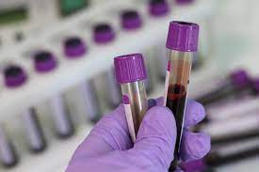
Multi Cancer Screening or AI technology?
Could be answer - Cost effective and reduce the amount of testing screening for multiple cancers
PanSEER – Cancer SEEK – Galleri are three manufactures of multiple cancer screening
Wildly used in America for fire fighters - Under NHS trial (only covers over 50 years old cohort)
2 years away from NHS approval and reaching required milestones
Galleri currently do not have the testing infrastructure in UK.
Galleri would need to perform testing on younger demographic 35-49 to ascertain product research data.
Notes:
Multi Cancer detection screening methods
The theory and scientific papers of this method show promise and are cost-effective to provide early detection. This could save the authority time and money in the long term and speed of routine period medical.
There are two types of methods non methylation or methylation and have various sensitivities reference scientific document https://www.ncbi.nlm.nih.gov/pmc/articles/PMC8883983/
Detecting cancer at an early stage, when primary tumours are still localised and have not spread to the surrounding tissues, remains the best strategy for successful treatment and increased overall survival rate. This is because, when detected early, tumours can be effectively treated by surgical means or, localized radiotherapy or chemotherapy.
Survival rates decline drastically with late-stage diagnosis, particularly in metastatic cases which are frequently associated with poor prognosis. Early detection also enables reduced medical costs as expensive and long-term treatment accompanies later disease detection.
Conventional diagnosis of cancer burden still relies on reporting symptoms and medical imaging of a single tissue at a time, followed by tissue biopsy for histopathological analysis when a mass is detected. Such a process is often ineffective for early cancer detection as it relies on symptomatic and phenotypic changes that typically appear at an advanced stage of malignancy.
The criteria of screening healthy individuals’ method would need to achieve a maximal specificity of 100% to limit the false positive rate to 0% and ensure adequate clinical risk–benefit. A false-positive result would misguide any firefighter towards further clinical testing, with concomitant negative impacts on patient mental health and healthcare system burden.
Galleri –
There are many screening methods which need to be fully evaluated and reviewed. The NHS is currently researching the Galleri test. The Galleri test is not yet approved in the NHS, but trials are ongoing. A request was made to be a part of the NHS trial but unfortunately, this is not possible at the time of writing. It involves a blood test which can screen for 50 various cancers with varying sensitivity and investigates the genetic changes of DNA at a lower cost £900.
This only test 50-70 years olds and does not consider the younger demographic of fire fighters. There is question on ensuring the reliability and issues surrounding false positives.
Reference
Klein E, Richards D, Cohn A, et al. Clinical validation of a targeted methylation-based multi-cancer early detection test using an independent validation set. Ann Oncol. 2021;32(9):1167 – 1177.
Galleri test requires a doctor to prescribe/undertake the test. It is recommended for screening in any adult with an elevated risk of cancer such as firefighters, those 50 or older, those with a personal or family history of cancer or anyone interested in early cancer detection.
This screening method appears to have been extensively used by firefighters in America for some years. The result is either positive or negative and can be used to identify the location of cancer which then requires confirmatory diagnostic evaluation by medically established procedures (e.g imaging) to confirm cancer
The test should be used, annually, but as stated previously that may not be possible with the LFB owing to cost and logistics. In addition to guideline-recommended cancer screenings such as mammography, colonoscopy, PSA (prostate-specific membrane antigen), cervical cancer (Pap smear and HPV testing), lung cancer screening and other screening tools should still be used.

Slide 20
Breakdown of Cancer care
Prevention – Performing contaminants policy and reducing exposure.
Detection – Is key to survivorship and onward care and treatment.
Bring awareness to cancers to all personnel, close links to charities.
Instruction to perform self-checks and the signs and symptoms.
Hold Teams seminars to get wide scope of personnel.
Cost effective way of increasing knowledge -Shower posters – Instructions?
Diagnosis –Treatment - Survivorship support- How we look after personnel following cancer diagnosis – Survivorship program -Back to work scheme?
Notes:
Show the steps of key elements that need to be considered. Read slide as is…

Slide 21
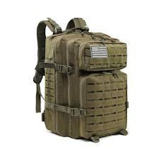
Personal bags
Small holdall for FF ancillary items
Use in additional standby kit bags to store personal items and away from structural PPE.
The new MSA BA set will come with an individual facemask bag which can be used to store gloves and respirators which is an improvement to stowage and concerns amongst firefighters..
Notes:
Personal Bags
Small holdall for FF for ancillary items etc have been investigated by Fleet. A small holdall in conjunction with the standby kit bag working group is currently led by SC Robinson. A small kit bag that could be used for items such as a respirator, spare gloves, and fire hood could be stowed.
The new MSA BA set comes with an individual facemask bag which can be used to store gloves and respirators which is an improvement to stowage and concerns amongst firefighters.

Slide 22
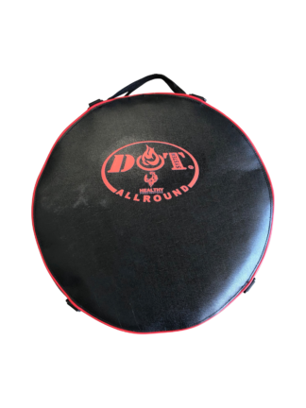
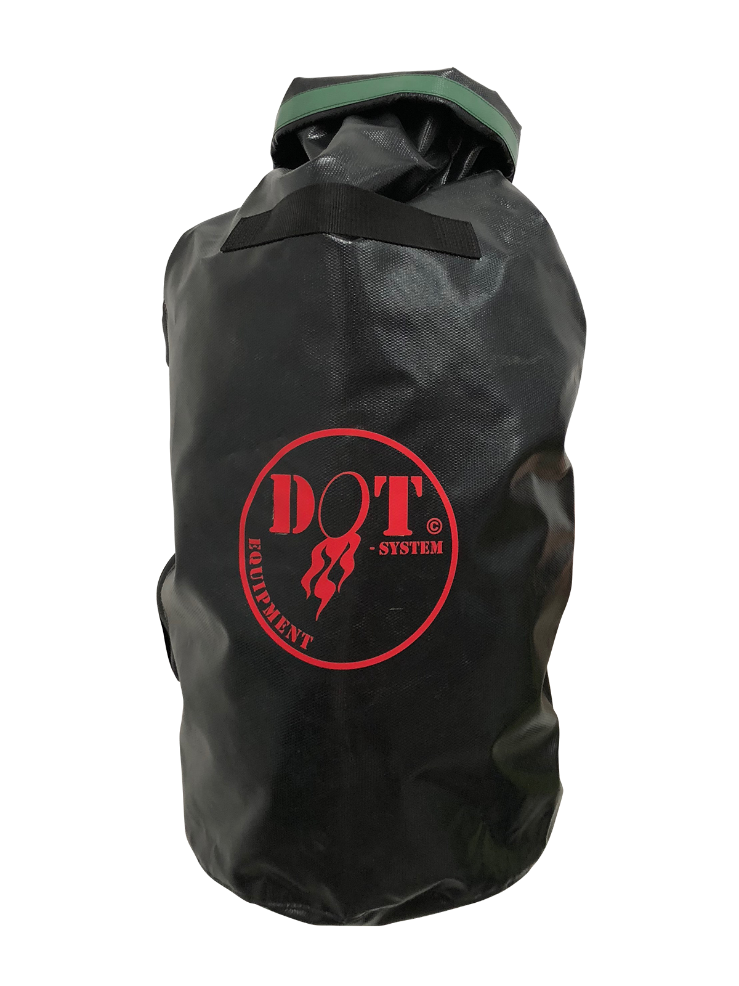
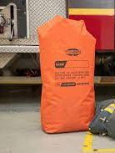
Replacement polythene bags - & Storage of PPE - Senior Officers Vehicle’s
The extent of contamination of PPE to senior officers may only occur in rare occurrences owing to their role and location on the incident ground.
They have access to polythene bags but there could be a more sustainable option available
Stowage of PPE in vehicles needs to be standardised using airtight bags or containers.
Notes:
Storage of PPE senior officer’s vehicles– The extent of contamination of PPE to senior officers may only occur in rare occurrences owing to their role and location on the incident ground.
Monitor environmental impact of policy owing to wipes and use of polythene bags.
Stowage of PPE in vehicles needs to be standardised using airtight bags or containers. They have access to polythene bags but there could be a more sustainable option available.

Slide 23
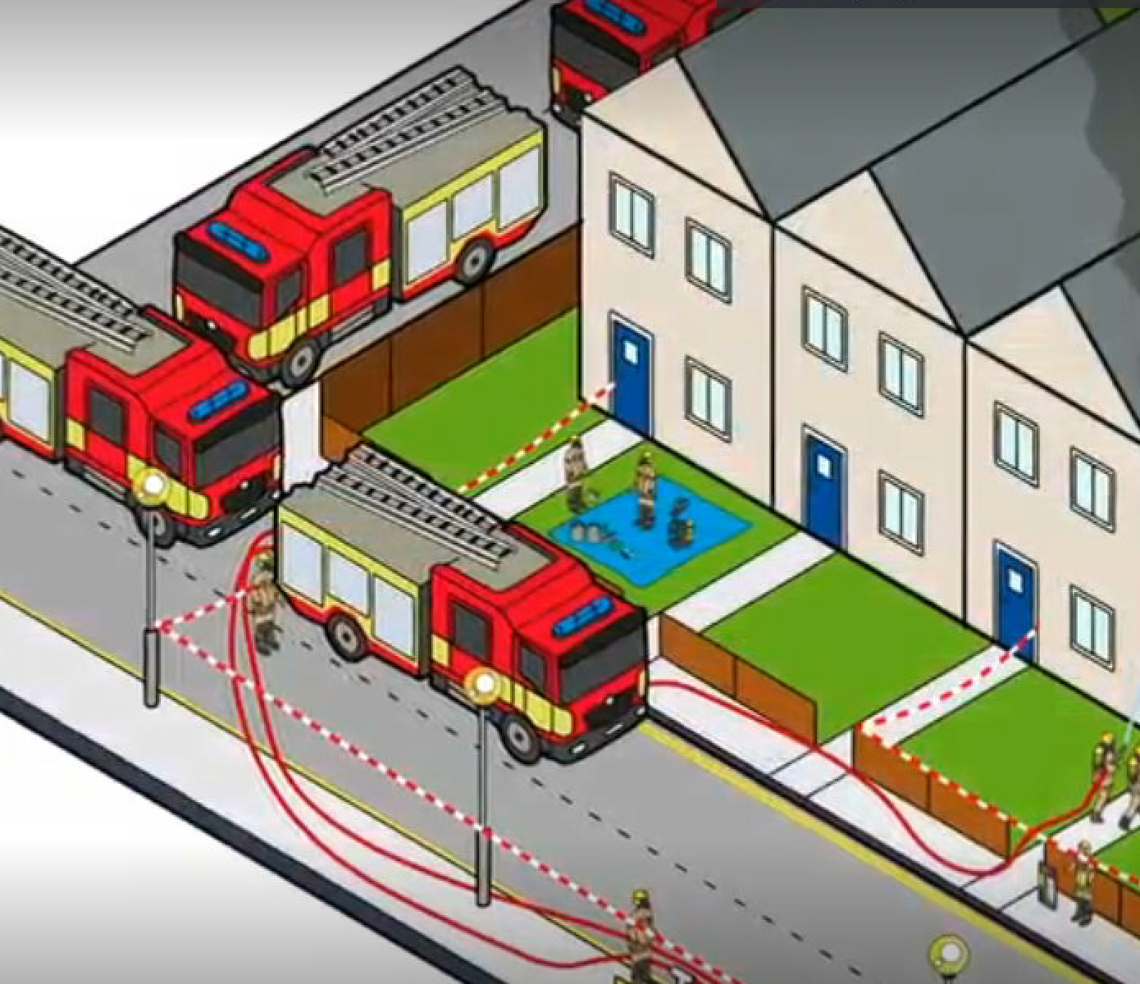
Incident Ground
Foam - Although a carcinogenic risk there is sperate legislation ad covered in a separate business case.
Procurement of additional and new PPE
BA Welfare vehicle
Detective and identification – Control Measure Improvement of gas detection
Respirator Filter – Improvement
Replacement of fire contaminants polythene bags with a more sustainable and reusable option
Appliance – Alterations / Deep cleaning
After we leave document
Notes:
Incident Ground
Foam replacement – Although a carcinogenic risk there is sperate legislation and covered in a separate business case.
Read the reviewed possible changes- Read slide as is….

Slide 24
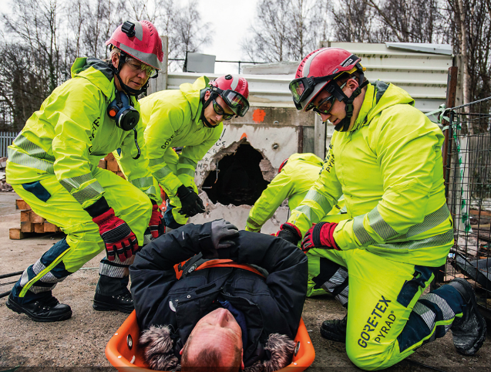
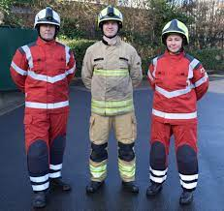
Procurement of additional and new PPE
Highest priorities owing to the policy’s impact on operational incidents and efficiency.
Specification of PPE, standards, logistics, management, cleaning lifetime is significant factors
2 years remain on the existing PPE contract. Any additions or changes to this contract are likely to come at a cost
New level of PPE is there is not one size fits all approach – The use dictates specification. (Technical rescue or wildland rated PPE both have separate standards)
PFAS future within PPE – What issues does this create? If replaced with Silicon alternatives reduces risk from oils and invalidate ‘Orchid research’ into PPE CBRN.
Notes:
Procurement of additional and new PPE
This has one of the highest priorities owing to the policy’s impact on operational incidents and training. This was a known risk of the policy implementation but also highlighted incident review.
Who requires structural PPE officers/ FF/ Specialist roles? Can it just appear the same.
Spare PPE is required owing that firefighters have nothing to change into after following the disrobe procedure following a BA wear.
Currently 2 years remain on the existing PPE contract with MSA/Bristol and there is no technological review. Any additions or changes to this contract are likely to come at a cost.
Logistics and management of PPE, could station go to other station if their size isn’t available. There are issues with using the existing SRS store, and stowage availability of spare PPE on the appliance owing to the size of the spare PPE.
There is a need and requirement for a solution for additional PPE, the specification and purpose will dictate its specification.
Research in PPE shows that there is not one size fits all approach to PPE. European fire services have specific PPE dependent upon the task e.g. technical rescue and wildland fires.
Any future new PPE will have to ensure there is a resistance to fire contaminants and diffusing through to workwear such as particle bocking flash hoods/gloves etc. However, the more protection you add it will ultimately affect the physical ability of the firefighter. The NFCC specification of PPE, is vital the membrane would suggest that it would protect against fire contaminants and blocking off areas within leggings may increase heat stress and increasing thermal protection would increase this further.
PFAS risk from textiles is a potential issues as seen in America, if there is a solution to PFAS free alternative with same performance levels currently then that would an available alternative. It is not possible to achieve or recoat the outer layer currently PPE limited to 40 washes. Flame tests , chemical resistance standards
Silicon alternatives will mean there is a reduction in this standard in regard to oils, possibly a substance that we are most exposure too and would invalidate the research from Orchids project and PPE into chemical protection from CBRN incidents. This will all need to be considered.
Proper research testing into the dermal and uncontrol testing (real world) to ascertain the risk from not only fire contaminants but PFAS migration.

Slide 25
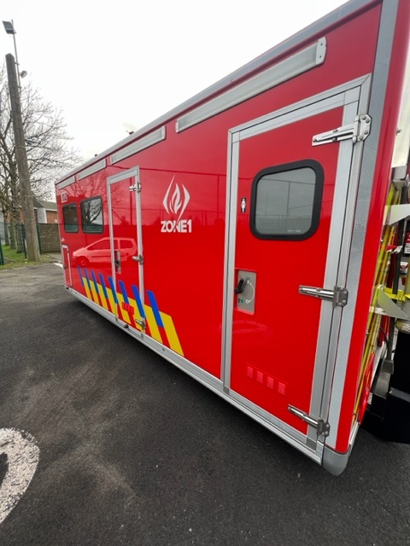
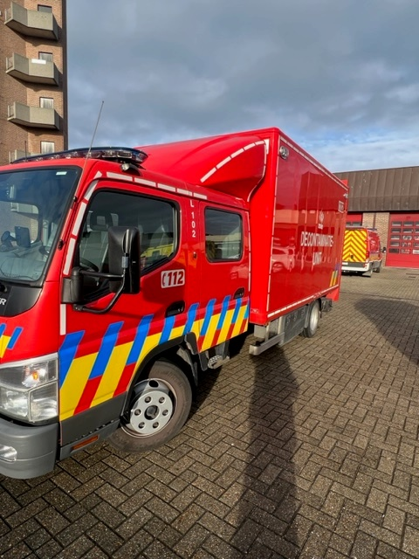
Welfare vehicle
This is not short-term response and likely to involve a significant timeframe to create a specified vehicle, design and costs, but should be addressed when these items are up for retender.
Notes:
BA Welfare vehicle /Operational Support Unit -OSU –PHU - The current public health unit LFB uses is currently up for tender and along with a report proposal of how the OSU will develop and be managed in the future. There could be an opportunity combined with this and create a BA welfare vehicle like the one pictured below by our European colleagues.
This could be mobilised for confirmed 6 pump fires where BA is likely to be extensively used and could contain toilets /shower and a tent which could be used as a staging area / changing area for workwear if was found to be proven that the extent of contamination to workwear was sufficient that it required removed and changed.
The precautions taken in Europe may not be affective in a busy city area. Their incident rate and risks are significantly different.

Slide 26
Welfare Tent
Inflatable tent for changing from workwear if required or sheltering from the elements
Could be stowed on OSU
This item is extensive used by Nordic countries and Australia.
Notes:
Read as is – Cost TBC

Slide 27
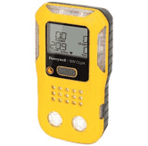
Detective and identification – Control Measure
Basic gas detection equipment on all front-line appliances P/PL
There is scope to improve our ability to detect toxic industrial chemicals at fires for toxic industrial chemicals such as hydrogen Cyanide and or photoionization detection
The CBRN team and scientific advisors can perform regular air monitoring, who can record the atmosphere and particles within the air during the emergency phase of the incident and provides resilience to the control measure.
The use of drone and other weather applications for plume monitoring
Notes:
Detection and identification – Control measure – There is basic gas detection equipment on all front-line appliances P/PL. There is scope to improve our ability to detect toxic industrial chemicals at fires for toxic industrial chemicals such as hydrogen Cyanide through gas detection and photoionization detection.
This will be a part of a separate growth bid to give greater detection capability on the incident ground.
Environment consideration for public and handover.
At larger scale incidents this will have to be a consideration and the contamination after the fire to soil etc could be subjected to longer term monitoring. But this wouldn’t be the role of the FRS

Slide 28
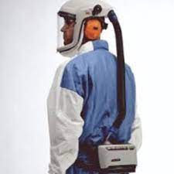
RPE – Strategy
Stay of the smoke were possible!
The current P3 filters offer particulate protection.
Is there a difference between transient and prolong exposure? Weather changes !
There is an increased level of protection available, which can filter out chemical vapours’ parts.
Chemical vapour can be produced during and post fire which may not necessarily adhere to the carbon particles.
There will be an increased cost - P3 filter - £6 per filter and vapour filter is £26 per filter.
The requirement for powered respirators – Fire investigation / support staff.
Notes:
Our Scientific advisors – Performed regular monitoring at significant incidents and found at ground level chemicals and to stay of smoke.
Risk assess exposure. –
Incident commanders need to have situational awareness on the incident ground. This is achieved by ensuring they have risk-assessed the exposure to fire contaminants in their risk assessment by considering the following:
• the materials alight
• the fire size
• smoke volume and density
• duration of exposure
• life risk
• Is their significant benefit to not implementing all control measures? The only justification for not implementing control measures would be immediate risk to life.
An RPE strategy and risk assessment must be completed at every incident; staff working at height may be more affected than staff on the ground.
There is also a difference between what is a transient exposure from smoke or a prolong exposure through a change in conditions and must be continually be monitored to keep the exposure as low as practicable.
Respirator Improvement Filters – The current P3 filters offer particulate protection, there is an increased level of protection available, which can filter out chemical vapours’ parts. Chemical vapour can be produced during and post fire and may not necessarily adhere to the carbon particles and this will over greater protection.
There will be an increased cost is significant when compared current P3 filter cost £6 per filter and the proposed new version is £26 per filter excluding any potential bulk discount.

Slide 29
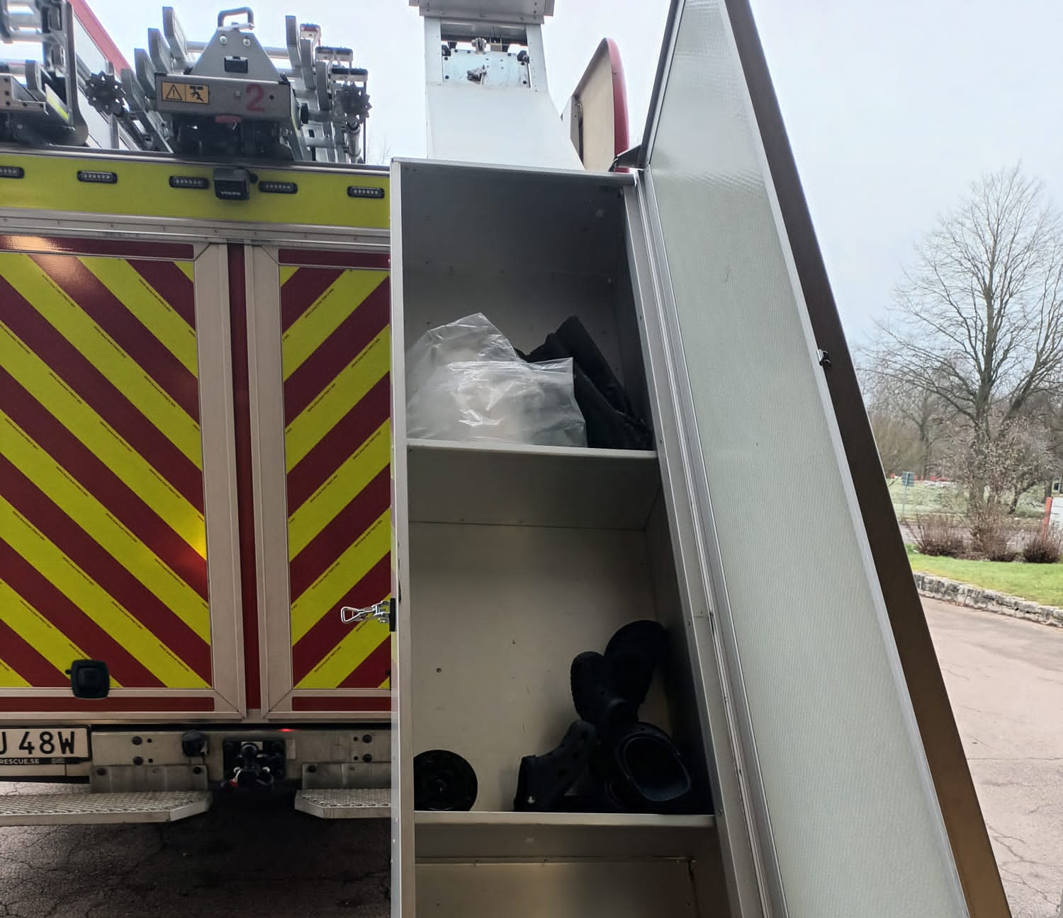
Appliance Alterations possibilities ?
Clean Cab – Policy ? Cleaned – decontaminated – clean plus
Sweden have locker that is electronically powered and used to store clean clothing
Improve stowage significantly for MTFA equipment and potential PPV
Cost and time scales unknown
Could be included in future specification current fleet due for replacement in 4 years.
Notes:
LFB have taken that BA and thermal image cameras will remain in the cab currently only the risks of access and single roadways and items like thermal image camera will remain as this will affect response on the incident ground and safety fire fighters.
If there is alternative that does not affect this then should be taken.
Cost and time frame would be extensive to change now – 149 operational appliances 30 spare appliances which is the size of Surrey FRS. This is the type of logistics that LFB faces.
The example is from Sweden and show stowage of clothing and extra PPE

Slide 30
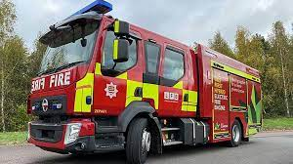
Appliance cleaning
The short term reinforce that fire appliance cleanliness is a part of daily routines
Long term looks at contracts or costing into appliance specialised cleaning either as part of the service and a mandatory task or on ad hock basis.
Notes:
Deep cleaning of fire appliance - The responsibility of cleaning front-line fire appliances should be performed by station crews initially.
Policy PN1000 should limit the extent of cross-contamination where equipment should be cleaned or bagged. Fire Stations should perform regular cleaning of locker cab as apart of station routine. Crews have sufficient PPE, plastic aprons, P3 masks, nitrile and decon gloves if required.
LFB should consider exploring a deep cleaning contract on fire appliances for fire contaminants. The current vehicle contract does not cover specialist cleaning. This is currently being used on an ad hock basis. Most recently a fire appliance required specialist cleaning following a tyre fire leaving black deposits on the external surfaces.
There are historical issues of fire contaminants building up through improper or poor cleaning. Textile material should be properly cleaned as per EU standards where possible.

Slide 31
After we leave document
This informs public the risk associated with fire contaminants recommending P3 filter / Tyvek suits / gloves. Gold Standard but not necessarily required what is the exposure over the lifetime is there a great impact from other sources diet etc.This will dissolve the responsibility LFB has after the incident, protect the public and considers risks from EV’s
Recommendation of contaminated clothing/medicines, Local authority will also need their own risk assessment / policy from occupational health.
Notes:
After we leave document – After the fire typically the occupier of the property will leave to recover the scene after the incident fire crew would typically leave an after we leave document. If the individual is uninsured, it is a reasonable assumption that they would clean and restore the property without any additionally PPE. This document requires updating to inform them of the risk associated with fire contaminants recommending P3 filter and Tyvek suits. This will dissolve the responsibility LFB has after the incident, protect the public and should recommend protection.
This has been actioned and under review for publication.

Slide 32
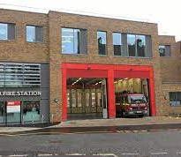
Station and Property
BA and Hose Wash Plant
Contaminant Wipes + Soaps
Laundering of PPE and workwear
Zonal Areas
Review of BA cleaning facilities station level
Storage of contaminated PPE
Notes:
Fire Stations / Property
Reviewed a number of areas : Read slide as is….
LFB have procured BA wash plants and where we can announce the winner.
Providing soaps on stations
Laundering of workwear
Improvement to marking of zonal areas
Zonal areas – Temporary posters were introduced November 2022 to improve separation at stations surrounding fire contaminants. This should significantly reduce the levels of chemicals which have been found in clean areas of the station such as dorm, gyms and office areas.
Property should investigate painting the door surrounds or tapping a colour red, yellow and green would be an effective way of marking these areas. It is a cheap impactful way to identify the areas and would reduce the potential cross-contamination of fire contaminants.
https://www.ctif.org/sites/default/files/2020-11/FBU%20UCLan%20Contaminants%20Interim%20Best%20Practice%20gb.pdf
Review of BA facilities – Procurement of BA wash plants at central facilities but to increase access whether this a borough solution or mobile version is being explored.
Storage of PPE – Storage of contaminated PPE needs to be stored in a well-ventilated area to be in a well-ventilated area, the appliance bay or outside would be a suitable location using a locker or portable storage shed as shown below.
Consistent storage of PPE locations across the authority by moving all drop off and collection of dirty PPE to the outside. Use securable external storage lockers as shown in appendix or similar
This will also improve MSA/Bristol in their collection by only accessing the rear yard of the fire station
Low cost

Slide 33
Increase Understanding the risk?
What is the great risk, inhalation is primary but what is second ? Ingestion or dermal.
What is contaminated or clean? Do you have an assured decontamination process.
How long between contamination of skin and decon before it becomes ineffective, contamination to hair!
Understand the pharmokentics is difficult to understand surrounding FC or PFAS absorption. Urine is not always an accurate reflection of skin absorption.
Resilience / logistics – Understand the specific challenges risks fire service face – Management of personnel – equipment. European fire service has 1 incident week LFB faces multiple. How manage reliefs or personnel what is reasonably & practical?
What does current PPE provide in terms of dermal protection with age - PFAS
With a mixture of chemicals on the skin or chemicals broken down there is likely they would be a synergetic effect to the body.
LFB trying to drive the standards on particulate testing real world dermal risk with Hertfordshire University and decontamination.
Notes:
The biggest association is we know that cacogenic material exists on the incident ground. What is the greatest risk dermal or inhalation? Is there a synergtisc effect on the chemical on the body.
What constitutes clean or contaminated more on cleaning later!
How long between contamination and decon – Stated shower with hour but how practical is that? Incident ground continuity.
How do you potentially manage personnel that are more likely to suffer from prostate cancer and stations.
Resilience in supplier their location and process to ensure you can maintain the operational effectiveness of the FRS. Each FRS is different with the risk, personnel resources and budget. Pandemic risk or war need to be considered.
PFAS what is the replacement – NFPA colleagues are looking to remove PFAS but understand the risk FRS faces and where FF are ultimately placed in risk areas.
What does PPR do with age in terms of protection does it still maintain the NFCC specification for heat and flame and chemical protection.
LFB want to understand this risks more to find a balance.
Read as is…
General feedback:
The tradition of first appliance on scene remaining at the incident needs to be reconsidered. Consider an appliance that hasn’t had much involvement as other and with fresher crews. This would allow BA teams to return to station sooner for a shower.
Set up of decon area and contaminated personnel disrobing will affect resources at the incident and needs to be taken into consideration.
Urgent reliefs can be order when all crew members have worn BA and disrobed the incident doesn’t necessarily have to be increased in size.

Slide 34
Cleaning is key – What about logistics ?
Whether this body of a fire fighter or clothing or BA sets. What constituted contaminated or clean or decontaminated ? Terminology beware!
What standard are you achieving - NFPA/ BS / OKEO Annex 6 /own specifications requirement. How is this achieved? How Long? Resilience in supplier? Environmental considerations !
Scientifically independent and manufactures proven method– What is the cross-contamination risk – Assurance!
Removal of human error!
Manufactures ‘approval’ –What has been the approval process? entire garment not cross section of textile or
Environmental consideration and do they have exemptions – PFAS or fire contaminants
Notes:
There is currently no assurance on the current efficacy of cleaning of PPE and the process within the current contract or British standards. It would be a clear that some further assurance for the remaining of the contract is performed by an independent scientific research establishment for all layers of the PPE at the expense of the laundry provider.
This will help with assisting with what standard of cleanliness is provided and how it can be improved. Ideally a cleanliness standard specification needs to be decided upon examples whether OKEO Annex 6, NFPA 70 percent removal or a hybrid. This will need to be considered in any future specification PPE contracts.

Slide 35
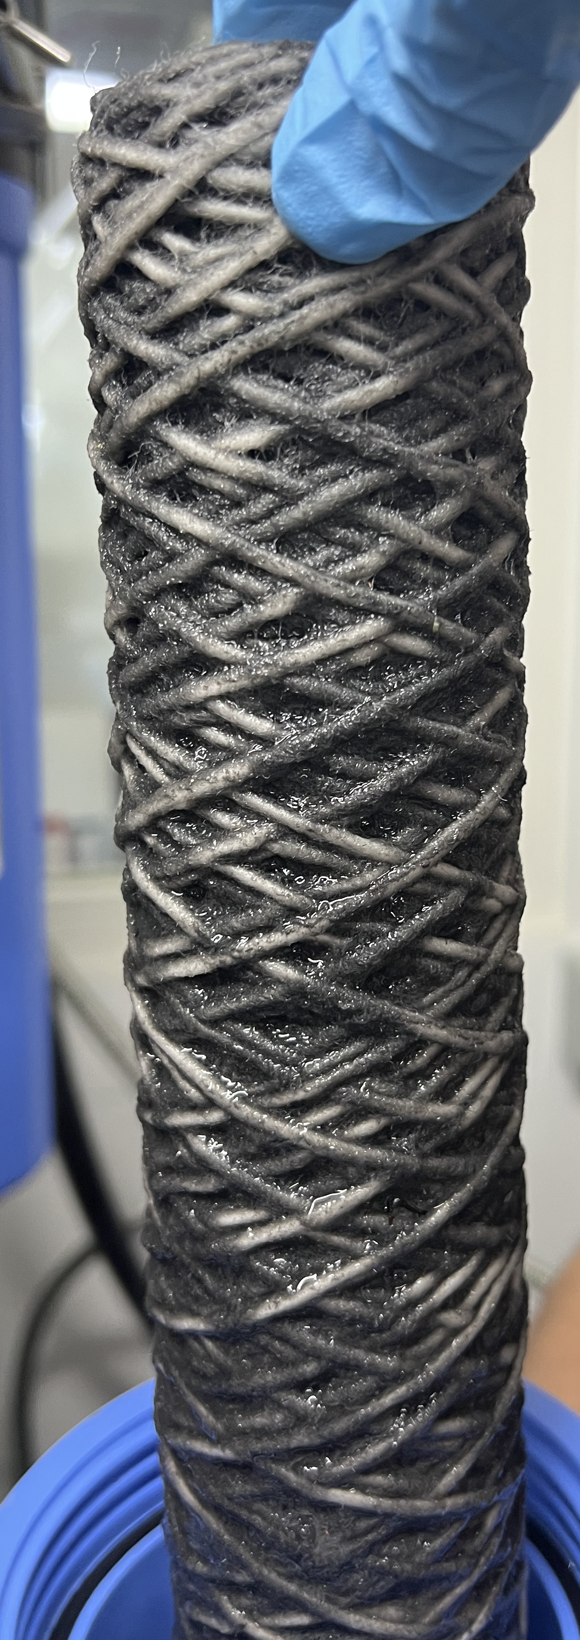
Variables in cleaning
Type, extent of contamination and material leather - textile – Fire contaminants - paints, creams, fire contaminants etc
Human / Automated (Time)
Water hardness and PH
Time between contamination and cleaning
Volume/weight of tunic and leggings or item being washed.
Type/Dose/concentration detergent
Volume / temperature of water both washing and number rising cycles
Innovative technology future - LCO₂ / Ozone
Notes:
Read Slide
The image to the right side shows a filter from a BA wash plant testing, it show the extent of historic contamination to ‘clean’ BA sets, this was a new filter and cleaned just 10 BA sets. This highlights the importance of washing down the BA set a scene which prevents contaminants drying and becoming harder to remove or ingrained and can also prevent gassing off which may occur.
This is the carbonaceous material which may contain cacogenic material. It is important to look after the set and one another.
BA sets should only be cleaned and serviced wearing appropriate disposal aprons, decon/nitrile gloves and half mask and P3 filter as per fire contaminants and BA policy’s.
Laundering with water and detergent is about 60% effective there are also cross-contamination issues, it does not effectively remove contaminants from all layers of fabric which make up structural PPE. It can damage the fabric to the structural PPE meaning that it may not offer the same protection against particulates or fire contaminants and requires further research. There is a risk here that PPE could be condemned sooner as a result of the research and have a direct effect on the PPE contract in the future

Slide 36
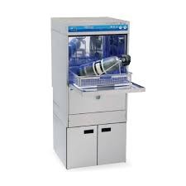
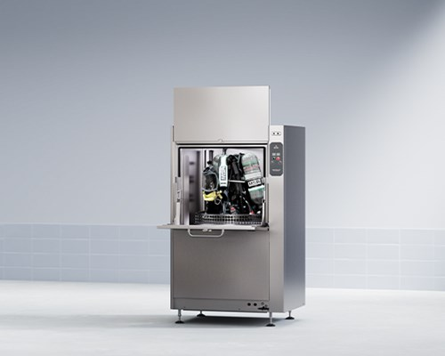
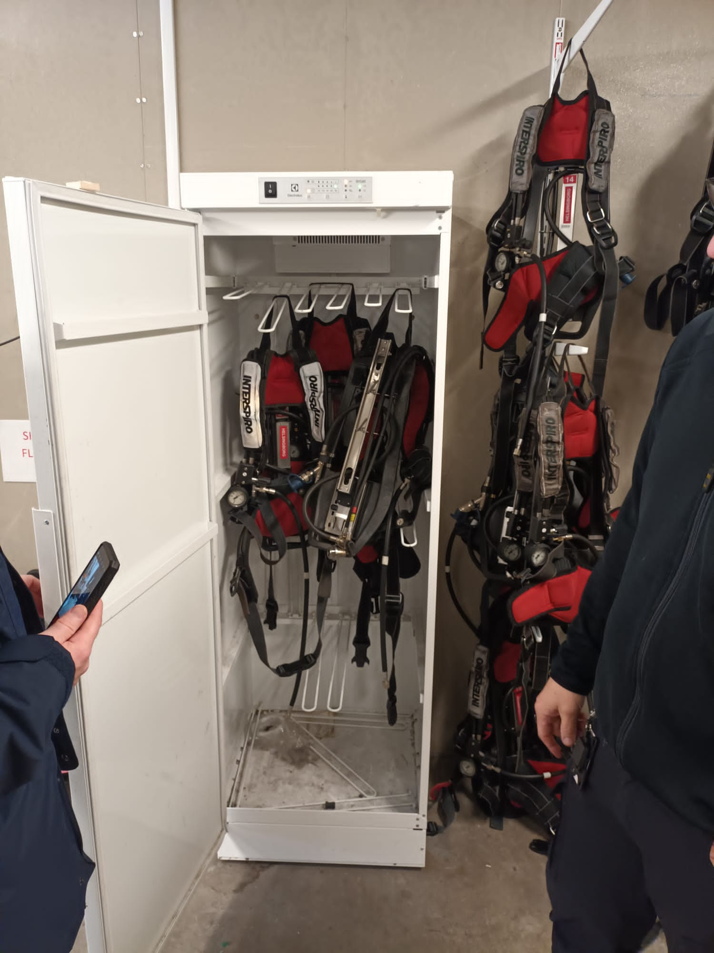
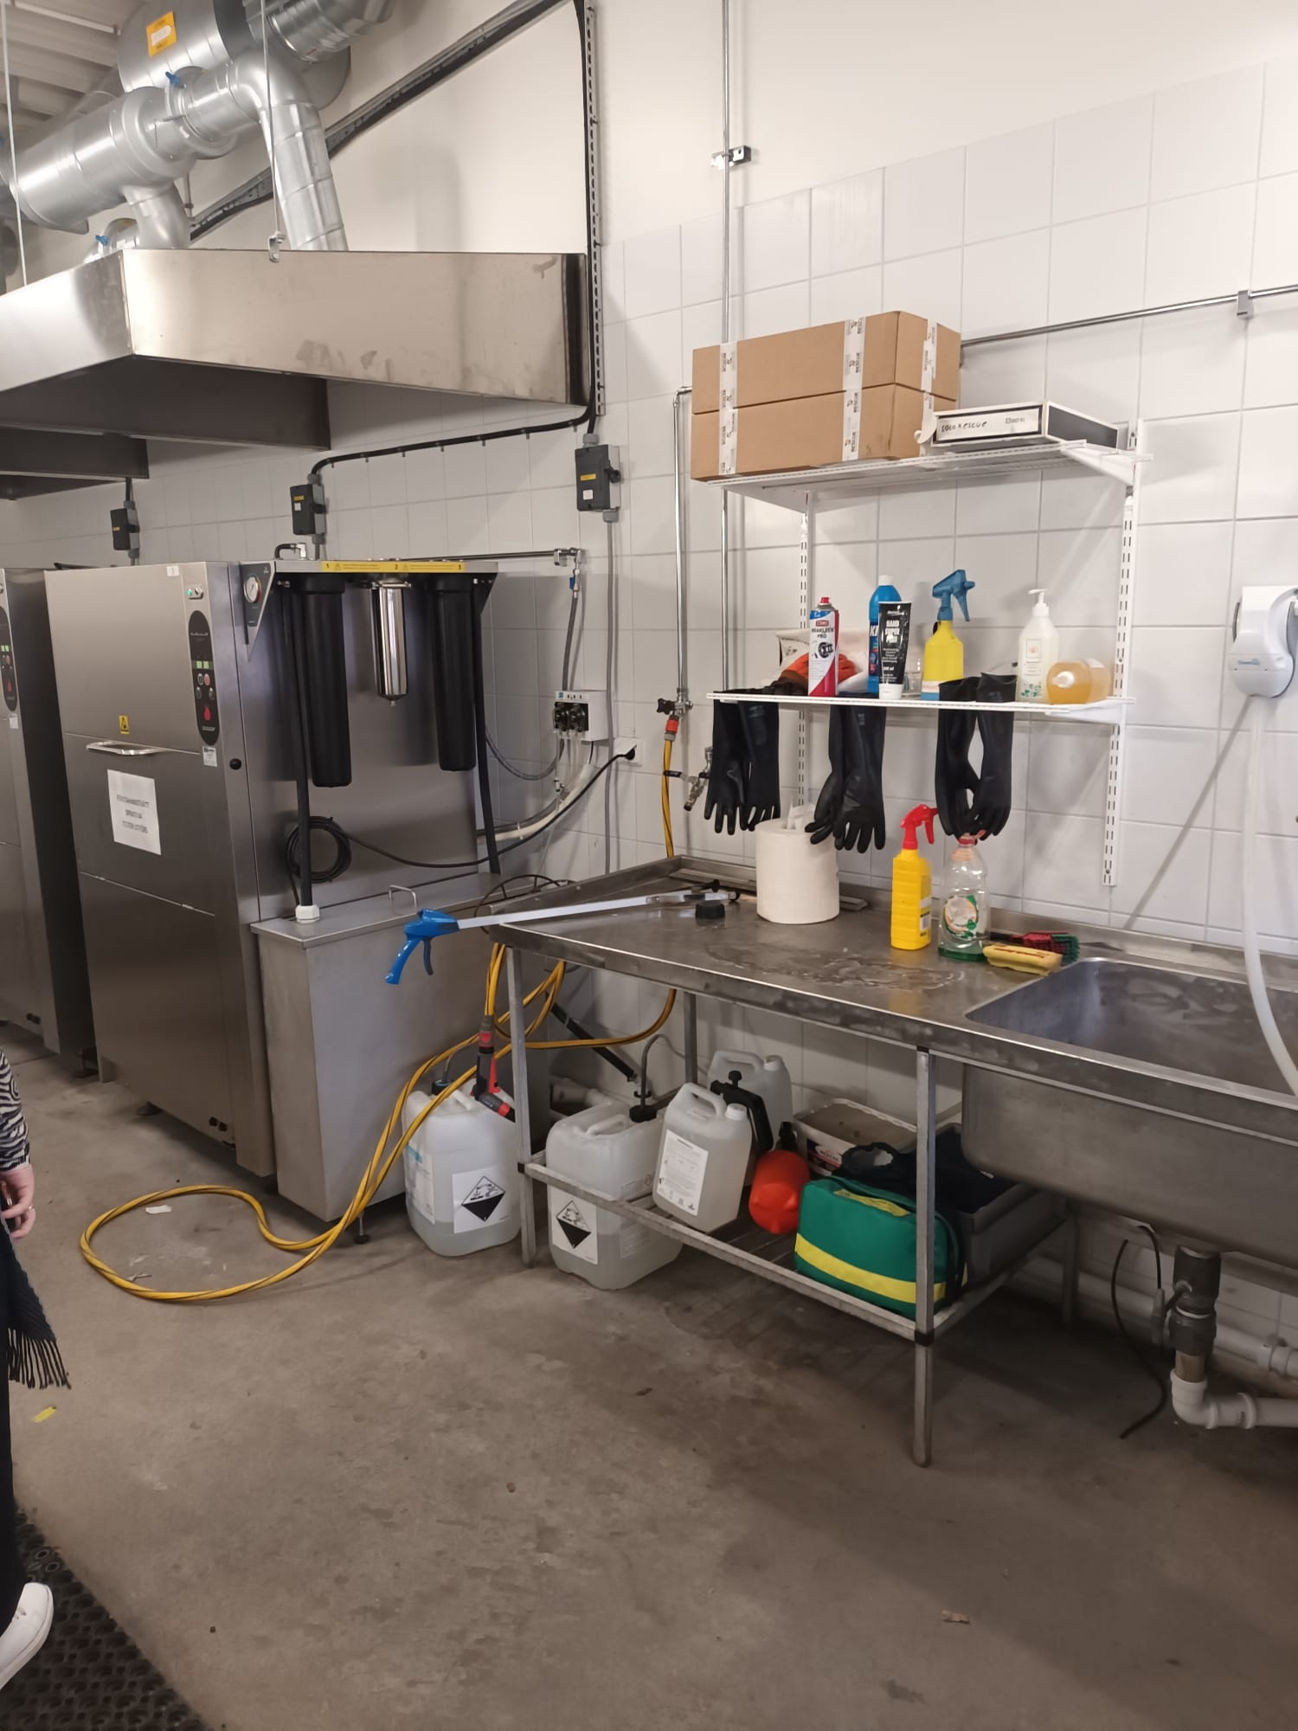
BA and Hose Wash Plant
Notes:
BA Wash Plants and Hose wash plants – Reference - https://www.mdpi.com/1660-4601/19/4/2240/pdf
LFB have reviewed BA wash plants and hose wash plants – we looked aqueous detergent based cleaning and dry ice cleaning.
1500 BA sets we have within the LFB.
Whilst dry ice appears effective, it's very slow and expensive. A collaborative may decrease the costs.
Wash plants are extensively used in the Nordic areas and America. Cleaning/decontamination is particularly hazardous process and requires an engineered solution to allow Firefighters to clean BA sets or items of equipment which will limit their potential exposure during the process but improve cleaning efficiency, which has historically been completed by hand. There are many manufacturers such as Meiko, Draeger and Rescue Intellitech (Bristol/MSA) and can vary significantly in price. (£11,000-£30,000 acquisition of appliance only) This should also reduce the dependancy on spare parts
Property, OPA hazmat and OSG have had BA wash plant (water and detergent) to be installed temporarily for fact-finding in July 2022 and developing a method which could allow stations to machine wash or hand wash BA sets. It has shown that it removes fire contaminants from breathing apparatus sets but this hasn’t been quantified.
BA - There are an industrial dishwasher for BA, helmets and could be used for small items of equipment such as branches.
https://www.meiko-uk.co.uk/en/products/cleaning-personal-protective-equipment-ppe/ba-mask-cleaning
https://www.rescueintellitech.com/en/solo-rescue-decon-washer/
https://www.respiroclenz.com/
Consideration was given to install a wash plant on a mobile vehicle, which would result in a significant cost but could offer a flexible to response.
Set a specification out based on our exemptions and findings. Pilots a range of appliances to see the differences and the variables.
Pressurising the BA set when cleaning and the variety of methods manufactures used. There is an element of cross over, but this represent better solution than the human error at 3am in the morning and can be minimise with ensuring wipe is used for the face mask.
Pressure of BA contract being issued to MSA- start and finish clean.
Typical washing time can vary of face masks from 10-20 to 1.5hrs and obviously effects the outcome along with variables already discussed such as temperature. However, LFB cannot have an appliance off for 1.5hrs – 2hrs OTR there needs to proportionate outcome and cleaning.
Cost / concentration per wash is massive consideration – cost – effectiveness – directly compare – also want reliability resilience should a machine fail, pandemic or supply issue war. Hence stipulated 3-month supply stocks with supplier.
Competitive process is likely to be destructive, would need the manufactures support and costly.
You are very much reliant on]
What we did fine is PFAS in the wastewater which is significant in particular the restriction on these products even though we have exemption from water provider. Environmentally we should be preventing forever chemicals entering the ecosystem.
The chemical they use must be approve by MSA owing that we are due to change this 2024. This could be extended to one per borough which would mirror the role of the MSA BA set proposal to prevent any historic build-up of fire contaminants under the same arrangement. Babcock should also be required to have this equipment at training venues to ensure good practice could take place.
The lease or subscription service would allow for flexibility and cleaning to take place but also keeping up with technological advances in this field. Long term it would not be cost-effective for the authority and allow for transition into the longer-term plan much easier.
Approved method from MSA owing to contract gruarneties, or underwrite from chemical dergernt that should damage occur that damage would be reimbursed.

Slide 37
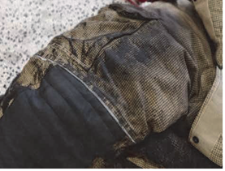
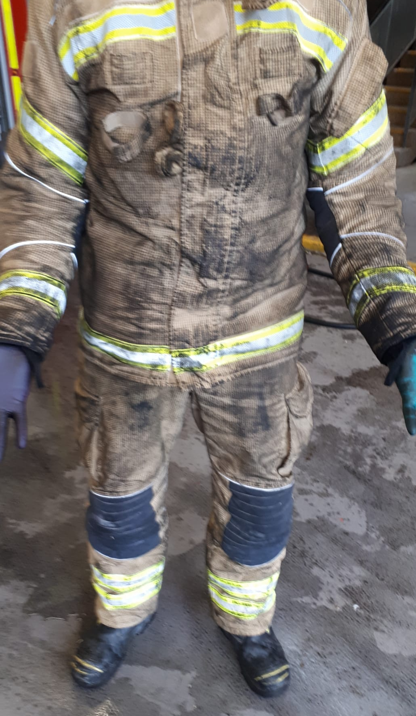
Extent of contamination to PPE & workwear?
The task the firefighter (FF) is performing e.g., compartment firefighting versus ventilation.
Concentration of contaminants
Porosity of outer layer of PPE
Age and fit of PPE (correct sizing)
Type of fire and or contaminant e.g., car fire, compartment fire.
Materials alight (carbonaceous fire or Lithium battery fire) Other hazardous materials such as asbestos
Duration of firefighting
Notes:
Cleaning / Laundry:
References;https://www.sciencedirect.com/science/article/pii/S1438463921002157
UCLAN document Cancer incidence amongst UK firefighters.
British standard 6817.2019 - Personal protective equipment for firefighters – Cleaning, maintenance and repair – Code of practice
The documents show that cleaning/storage is important for minimising exposure to fire contaminants. LFB has two contracts one for structural PPE (Structural PPE, flash, hood and gloves only) through MSA Bristol this current contract does not expire until 2027 and the other through Silverline which handles station laundry t-towels and other items from fire stations.
Note FF’s get tax relief, but this would not account for contaminated clothing, but this requires confirmation from a tax expert.
The scientific documents as referenced in Prof Stec showed that chemicals or fire contaminants may deposit onto the workwear. The method of testing involved US firefighting PPE. Without knowing the type, age, laundry history or specification it is difficult to accurately quantify whether this would occur in UK-spec PPE for compartment firefighting.
Grass fires pose a separate issue in that firefighters typically remove the tunic owing to physiological demands, which could increase the contamination of workwear and skin absorption through exposed skin.
There have been previous testing of PPE involving CBRN simulated chemicals and found that vapours are unlikely to penetrate between 15-30 minutes – Ref- An evaluation of the effectiveness of standard emergency services, Personal Protective Equipment (PPE) for performing snatch rescues in hazardous environments - November 2012 Health protection agency.
Testing is required to confirm the extent of contamination to workwear using a variety of ages of PPE. This will need to be completed using an appropriate method, in a controlled environment and there is a cost to investigate this further.
There needs to be a structured approach to PPE from how we launder/service the PPE and its availability to firefighters. This policy and risk will affect new contracts in the future. LFB is currently washing PPE more than what is specified in the existing PPE contract of 40,000 washes, the current target is 60,000. The PPE is collected at the station and replacement PPE is issued. When PPE is lacking it can result in the appliance coming off the run through lacking PPE with the SRS store at the station. The date is shown below.
Laundry of workwear at the time of writing the policy followed the FBU recommendations as stated in PN1000, intending to develop a more suitable process.
There is a risk with this that fire contaminants if not handled correctly could pose a secondary risk through cross-contamination and this is evident in the scientific document from Prof Stec or the need for professional cleaning.
Along with this you have wildland fires where personnel disrobe to t shirt leggings. LFB have explored using our existing contractor launder workwear as a short term measures. This has since stopped to complete a report.
LFB has two contracts one for structural PPE (Structural PPE, flash, hood and gloves only) through MSA Bristol this current contract does not expire until 2027 and the other through Silverline which handles station laundry t-towels and other items from fire stations.
It is not known scientifically know how much workwear gets contaminated there are significant variables to consider; age of PPE, type of fire grass or compartment, duration etc.
LFB do not have washing machines on fire stations – Consideration to borough cleaning facilities or mobile version. There is also the possibility of using washing machines for cleaning face masks / fire helmet.
Draw you attention to the ad hock testing from Essex fire and rescue that suggested that work wear whilst was minimal and how that contributes to dermal risk needs further research.
laundry contractor to be immediately available for station personnel following a BA wear incident as a matter of precaution.
Normal workwear with sweat etc should be washed at home.
The logistics involving such a process should be finalised by the procurement team and fire stations. The Station officer and Station Commander should periodically audit and control this process.
Ensure that MSA/Bristol contracts are adhering to British Standard 6817.2019 and EU standards when laundering and maintenance of PPE
Recommendation
Short term: laundry contractor to be immediately available for station personnel following a BA wear incident as a matter of precaution. Normal workwear with sweat etc should be washed at home. The logistics involving such a process should be finalised by the procurement team and fire stations. The Station officer and Station Commander should periodically audit and control this process.
Personnel at OSG have access to washing machines and permission should be given to launder workwear but ensure that training is given and the importance of rinsing the drum after washing to prevent cross contamination.
Ensure that MSA/Bristol contracts are adhering to British Standard 6817.2019 and EU standards when laundering and maintenance of PPE. Investigate the possibility of auditing the PPE cleaning process to ensure cleanness. This process may involve the destruction of PPE and would come at a cost. They should be performing annual maintenance checks on fire helmets annually or more frequently as specified and inspecting for cleanliness and cleaning parts that firefighters may not have access to.

Slide 38
Laundry - Incident facts and figures
Month | Coat | Trousers | Fire hoods | Gloves | Number of appliances status 7 for contaminated PPE | Number of incidents 3 pump and above | Number of primary fires | Total Duration of standbys - Fire Cover (Standby ordering booked status 15 to close of incident | Average of Fire Cover standby - Standby fire cover from status 15 to close of incident
Nov-21 | 1445 | 1529 | 375 | 247 | 145 | 57 | 776 | 31.13 | 2.59
Dec-21 | 1124 | 1221 | 345 | 173 | 198 | 61 | 705 | 74.92 | 4.16
Jan-22 | 1493 | 1499 | 396 | 209 | 145 | 55 | 691 | 148.62 | 3.03
Feb-22 | 1486 | 1493 | 635 | 666 | 151 | 50 | 628 | 89.87 | 3.21
Mar-22 | 1584 | 1611 | 728 | 769 | 237 | 56 | 751 | 138.70 | 3.38
Apr-22 | 1395 | 1414 | 558 | 555 | 246 | 66 | 769 | 220.77 | 3.81
May-22 | 2083 | 2107 | 858 | 1184 | 297 | 74 | 743 | 185.78 | 3.15
Jun-22 | 1549 | 1634 | 818 | 1010 | 349 | 91 | 795 | 147.28 | 3.07
Jul-22 | 1665 | 1996 | 633 | 467 | 688 | 177 | 1044 | 394.03 | 3.40
Aug-22 | 1994 | 3055 | 838 | 841 | 606 | 139 | 892 | 231.65 | 3.09
Sep-22 | 1279 | 1330 | 366 | 934 | 361 | 50 | 636 | 221.27 | 3.69
Oct-22 | 1299 | 1435 | 596 | 624 | 274 | 68 | 799 | 179.82 | 3.53
Nov-22 | 1696 | 1787 | 675 | 782 | 223 | 46 | 654 | 200.50 | 4.02
Dec-22 | 1656 | 1907 | 580 | 798 | 263 | 50 | 713 | 216.37 | 3.55
Jan-23 | 1684 | 1737 | 745 | 774 | 272 | 67 | 687 | 190.68 | 3.35
Feb-23 | 1672 | 1918 | 975 | 729 | 269 | 61 | 703 | 90.77 | 2.52
Mar-23 | 1726 | 2086 | 1121 | 1075 | 313 | 54 | 649 | 181.60 | 4.22
Apr-23
Average | 1578 | 1751 | 661 | 696 | 297.0 | 73.8 | 752.2 | 178.1 | 3.40
Fire contaminants monitoring group
Notes:
The fire contaminants monitoring group – sits outside the contaminants working group normally heads of service looking at the impact and changes which can be made strategically.
This shows the number of standbys and urgent reliefs since prior and slight after policy release. Are they taking longer are the number of urgent reliefs for fire contaminants increasing and the amount of PPE.

Slide 39
Standards
There are British standard 6817.2019 surrounding firefighter PPE cleaning and maintenance
There appears to be no UK limits on the concentration of chemicals within textiles which have skin contact – or what could be deemed at contaminated
OEKO-Tex Annex 6 set out the limits.
Notes:
There is a British standard 6817.2019 surrounding firefighter PPE cleaning and maintenance and this should be followed. There is a European standard OEKO-Tex – Annex 6 for the level of chemicals present within clothing which has direct contact with the skin. The limits have been set based on the health effects they can cause. Research on the extent of contamination to workwear will dictate how this is handled in the future. There is scientific research that contaminants from PPE cannot be removed using traditional water and detergent effectively to reach the guidance set out in EU standards. If there is any reason for not following this guidance or any other related industry standard the LFB should justify the decision scientifically where possible.
Any related procurement contracts either now or future surrounding this subject should maintain British or European or whichever is highest standards owing to that this could be legally exploited in future claims.
Firefighting helmets, boots and gloves are the most difficult items to clean through either their shape or the material from which they are manufactured. Leather causes the main issue through shrinkage. This has been found within the structural fire gloves after laundering and is detailed below.
Helmets and gloves are a significant source of contamination following BA wear. Both can be lightly cleaned with a wipe or low-foaming detergent at the scene or bagged for cleaning through our contractor MSA/Bristol.
There is currently no facility to deep clean helmets effectively and the cleaning is left to station personnel by hand. LFB need to be sure that MSA/Bristol is following the British standard procedure as listed below for helmet inspection.
This shows that the inspection requirement BS6817.2019
5.1.3 Helmets
Helmets should be inspected for:
a) soiling;
b) contamination;
c) physical damage to the shell such as:
1) cracks, crazing, dents and abrasions;
2) thermal damage to the shell (bubbling, soft spots, warping or discoloration);
d) damaged or missing components of the suspension and retention systems;
e) damaged or missing components of the face shield/goggle system, including discoloration, crazing and scratches to the face shield/goggle lens limiting visibility;
f) damaged or missing reflective trim;
g) correct fit and size compatibility of firehood.

Slide 40
Is specialist cleaning Liquid Carbon Dioxide the future..?
Process involves compressing the gas to a liquid or to a super critical fluid - 2 methods.
Cost circa £500,000
Uses around 1L of CO₂ per wash
Up to 12 sets of structural PPE
Can be cardon neutral and more environmentally than traditional washing
Can be used on boots, helmets gloves
Could be used Extend life of PPE
Notes:
Laundering with water and detergent is about 60% effective there are also cross-contamination issues, it does not effectively remove contaminants from all layers of fabric which make up structural PPE. It can damage the fabric to the structural PPE meaning that it may not offer the same protection against particulates or fire contaminants and requires further research. There is a risk here that PPE could be condemned sooner as a result of the research and have a direct effect on the PPE contract in the future.
Liquid Carbon Dioxide is a cleaning process involves gas being compressed into a liquid it is washed at a lower temperature and able to diffuse into all layers offering a more effective clean. This can be used on all items of fire brigade clothing including helmets and BA sets. Once the cleaning cycle has finished the pressure is released and the clothing is completely dry and ready to be issued or used again.
Research suggested it to be 99 per cent effective or all layers and can be used for hazardous substances such as asbestos and is used extensively used in Europe and America. It does not damage the fabrics which could in theory increase the longevity of the PPE which is currently 40 washes where typically the PPE is then condemned.
This is directly related to the workwear and PPE design, which is discussed in the PPE section, which is discussed further.

Slide 41
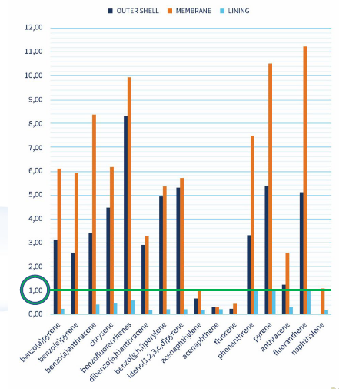
Is Liquid Carbon Dioxide the future..?
Traditional liquid detergent typically 60% effectiveness but could be more!?
It doesn't penetrate all layers of PPE .
It also damages fibres of textile removes water proofing- so limits life of PPE.
Graphs show levels of fire contaminants to specific layers.
Method of testing AfPS GS 2014
Notes:
Liquid Carbon Dioxide is a cleaning process involves gas being compressed into a liquid it is washed at a lower temperature and able to diffuse into all layers offering a more effective clean. This can be used on all items of fire brigade clothing including helmets and BA sets. Once the cleaning cycle has finished the pressure is released and the clothing is completely dry and ready to be issued or used again.
Research suggested it to be 99 per cent effective or all layers and can be used for hazardous substances such as asbestos and is used extensively used in Europe and America. It does not damage the fabrics which could in theory increase the longevity of the PPE which is currently 40 washes where typically the PPE is then condemned.
This is directly related to the workwear and PPE design, which is discussed in the PPE section, which has been discussed earlier.
Table shows contamination before cleaning

Slide 42
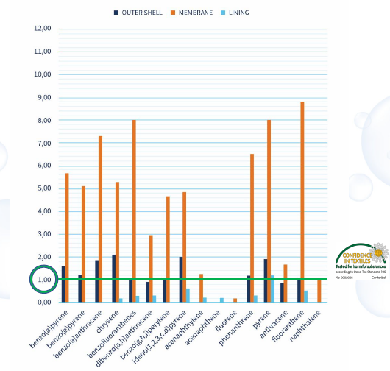
Is Liquid Carbon Dioxide the future..?
Traditional liquid detergent reduction of chemicals.
ISO 15797 standard
Notes:
Table shows contamination after what is left after detergent washing

Slide 43
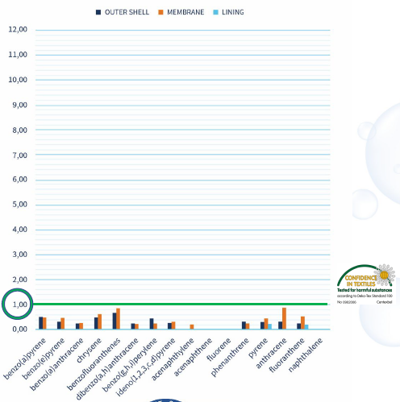
Is Liquid Carbon Dioxide the future..?
The results after liquid carbon dioxide cleaning.
Antibacterial
May also remove asbestos.
Notes:
Liquid Carbon Dioxide is a cleaning process involves gas being compressed into a liquid it is washed at a lower temperature and able to diffuse into all layers offering a more effective clean. This can be used on all items of fire brigade clothing including helmets and BA sets. Once the cleaning cycle has finished the pressure is released and the clothing is completely dry and ready to be issued or used again.
Research suggested it to be 99 per cent effective or all layers and can be used for hazardous substances such as asbestos and is used extensively used in Europe and America. It does not damage the fabrics which could in theory increase the longevity of the PPE which is currently 40 washes where typically the PPE is then condemned.
This is directly related to the workwear and PPE design, which is discussed in the PPE section, which has been discussed earlier.
Long-term - It is a reasonable assumption that there will be a significant impact on the contract costs of PPE and the laundering process in the future. Research into the extent of contamination to workwear and how it should be handled, and effectiveness of PPE is very important, it will allow LFB to better understand the risks and to negotiate PPE contract or laundering process in the future.
The correct equipment and correct methods is very important surrounding fire contaminants and should involve Liquid Carbon Dioxide cleaning. This process will remove significantly more fire contaminants when compared to traditional water and detergent methods and is the only method which can achieve the EU standard. It can be used on BA sets, gloves, fire hoods and structural tunic leggings etc. It will prolong the use of structural PPE by not damaging the fibres and reduce the downtime of the PPE as there is no drying time or drying room requirement and a significant improvement to service delivery.

Slide 44
Decontamination - Contaminant Wipes + Soaps
There are soaps specifically designed for the removal of fire contaminants from the body and hair available. How does this differ from normal traditional products isn’t what manufactures want to here
There are conflicting scientific reports regarding the effectiveness of wet wipes. Creation of waste.
Hertfordshire University has been extensively involved in decontamination for the US and UK governments.
The effectiveness of wipes and soaps should be further reviewed in particular hair decontamination a source of exposure.
Notes:
Read slide as is…
The reason for conflicting reports is the PRISM document from Hertfordshire University IOR pack and the PRISM document for CBRN materials state that removal of contaminants is through towelling and drying process.
Fire contaminant soap and wipes –There are soaps specifically designed for the removal of fire contaminants from the body and hair available. Research would suggest that lipophilic items are very unlikely to be removed from hair. How does certain Sopas behave what has the research that be performed a true representation of the body
A potential supplier- Dewipe could be installed at stations and training venues. There are conflicting scientific reports regarding the effectiveness of Ultragrime wipes and wet decontamination. Hertfordshire has been extensively involved in decontamination for the US and UK governments.
Recommendation
This is something that could be very easily implemented but is subjected to extensive research as to its effectiveness should be considered as high importance.

Slide 45
Risks
Procurement costs are yet unknown - Potential high costs – unknown costs to several areas of project ICT, medicals, and PPE contracts.
Failure to agree with the FBU.
Potential legal implication if not managed effectively and where possible base decisions on science.
Notes:
Procurement costs are yet unknown (dependent upon Corporate Management Board direction taken) - Potential high costs – unknown costs to several areas of project ICT, medicals, and PPE contracts.
Reluctant amongst stakeholders to adapt to the new research and implement positive practices.
Failure to agree with the FBU.

Slide 46
Reduce the risk Be cleaner Work smarter And use all available PPE

